Slide 1
Farming Successfully With Less Water
What Q-stable means, why the timing of conservation decides its value,
and what Sheridan 6 shows about both.
Micah Cameron-Harp
Department of Agricultural Economics, Kansas State University
Ogallala Fund · Scoping Discussion

Slide 2
Five questions
1
What does “Q-stable” actually mean for a western Kansas farm?
2
Why is earlier conservation worth more than later conservation?
3
What did Sheridan 6 really do, and what did it cost producers?
4
What has to change on the farm to make less water work?
5
What breaks during the transition, and who absorbs that risk?
2

Slide 3
Q-stable is a water budget
The pumping rate estimated to keep the aquifer level stable in the short run
The aquifer has income
Recharge, return flows and lateral inflow arrive every year.
Year to year that “net inflow” is steady enough to estimate.
Pumping is the withdrawal
Pump more than the inflow and levels fall.
Pump the inflow and levels hold.
Q-stable is where those two meet.
It is measured, not modeled
Built from metered water use and monitored well levels.
Kansas has metered wells since the 1990s, so the number is defensible.
In practical terms:
Q-stable is the amount that can be pumped without increasing the depth to the aquifer. It is generally lower than current rates of pumping, but it varies significantly across the state.
Method: Butler, Whittemore, Wilson & Bohling (2016), Geophysical Research Letters. Kansas application: Wilson, Kansas Geological Survey (2025).
3

Slide 4
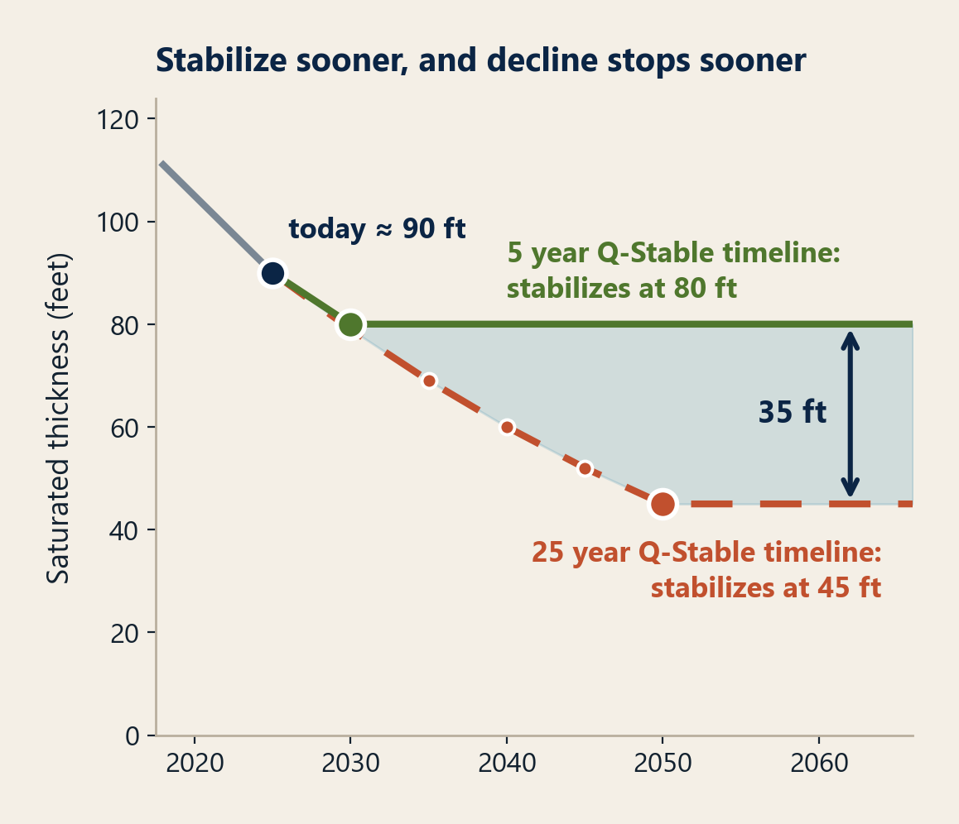
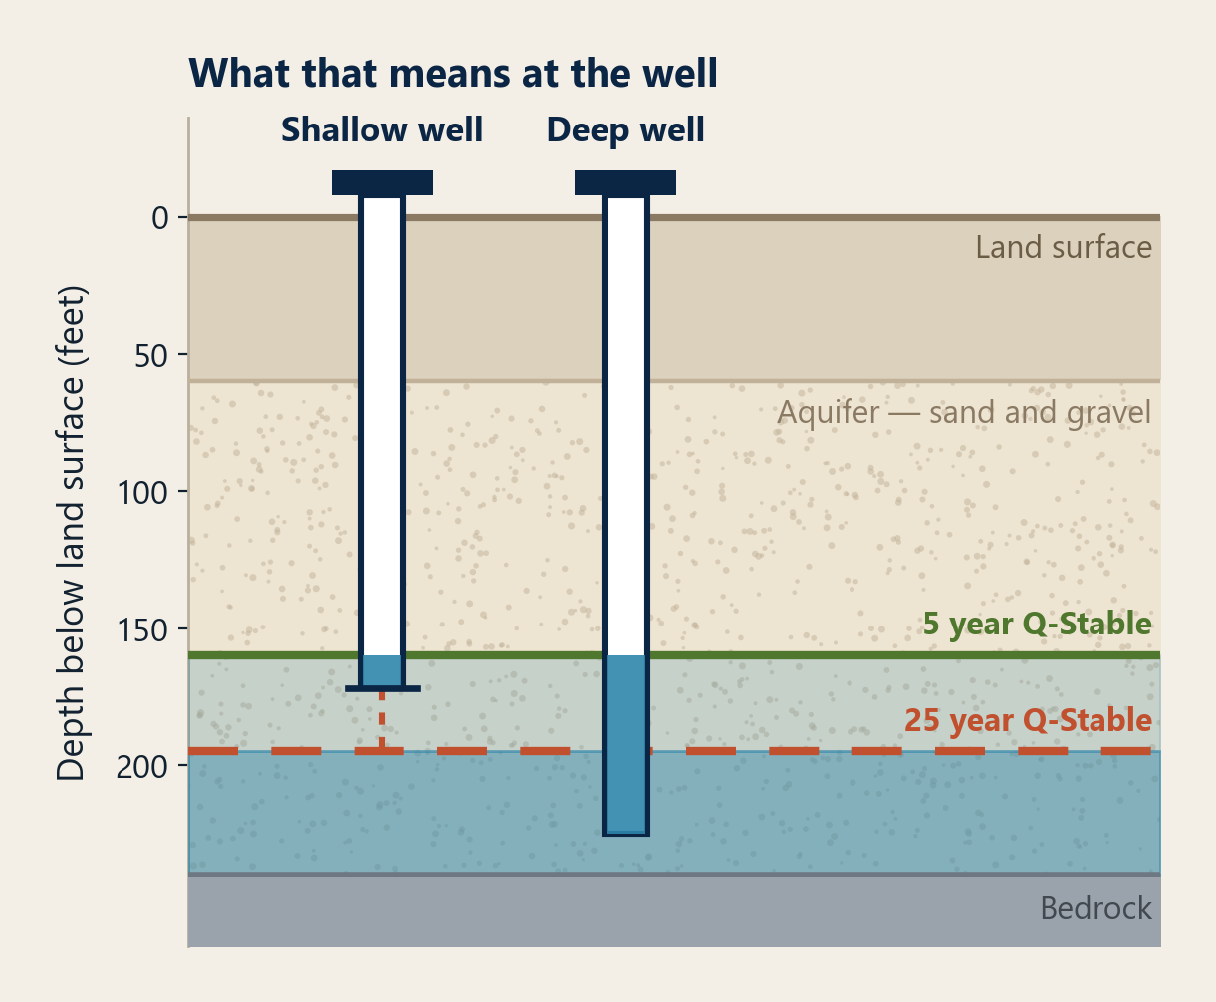
Why timing matters: the value of acting early
The same two wells, under a 5-year and a 25-year path to Q-stable
4

Slide 5
Why earlier conservation is worth more than later
The same percentage cut buys less, and costs more, at every stage of depletion
Acting earlier
Acting later
Well capacity
Full pivots run; efficiency upgrades pay back quickly
Yields fall below pivot capacity; wells must be deepened or replaced
Cost of a cut
Small trims stabilize; savings largely self-financing
Deep cuts required; capital needed before returns appear
Options open
Efficiency, scheduling, crop mix, timing
Fallowing and permanent retirement of irrigated acres
Land & collateral
Irrigated premium intact — roughly 50% over dryland
Premium erodes as saturated thickness falls; collateral revalues
Who can act
Producers, locally, with modest support
Requires outside capital, buyouts, or regulation
Irrigated land premium: Kansas State University land-value research; well-capacity thresholds: Kansas Geological Survey.
5

Slide 6
Many stakeholders, one aquifer
Why the timing question is not only a producer question
Producers
Water is the asset behind the operation.
Acting early preserves the choice of how to farm; acting late turns it into a forced sale or a dryland transition.
Lenders
Irrigated ground carries the loan.
A declining aquifer is a slow, correlated revaluation that hits every irrigated borrower in the county at once.
Supply chains
Elevators, processors and mills are fixed assets sited on the assumption of local volume.
Sourcing regions do not relocate cheaply.
Communities
Irrigated acres carry the tax base, the schools and main street.
Kansas projections put losses near $34M a year by 2050 on the current path.
The asymmetry worth naming
Producers carry almost all of the transition risk today, while lenders, processors and communities capture much of the benefit of a stable aquifer. Moving some of that risk off the farm is the case for a fund rather than a program.
6

Slide 7
THE WORKED EXAMPLE
Sheridan 6
The first Local Enhanced Management Area in Kansas, and the closest thing we have to a test of both arguments: a measured budget, and a late start.
99 mi²
northwest Kansas
(Sheridan & Thomas Cos.)
2013
first five-year
allocation began
−20%
pumping cut written
by the irrigators
55 in
per acre over 5 years,
spend it how you like
Designed over four years and eleven public hearings. Renewed twice, by vote, in 2018 and 2022.
7

Slide 8
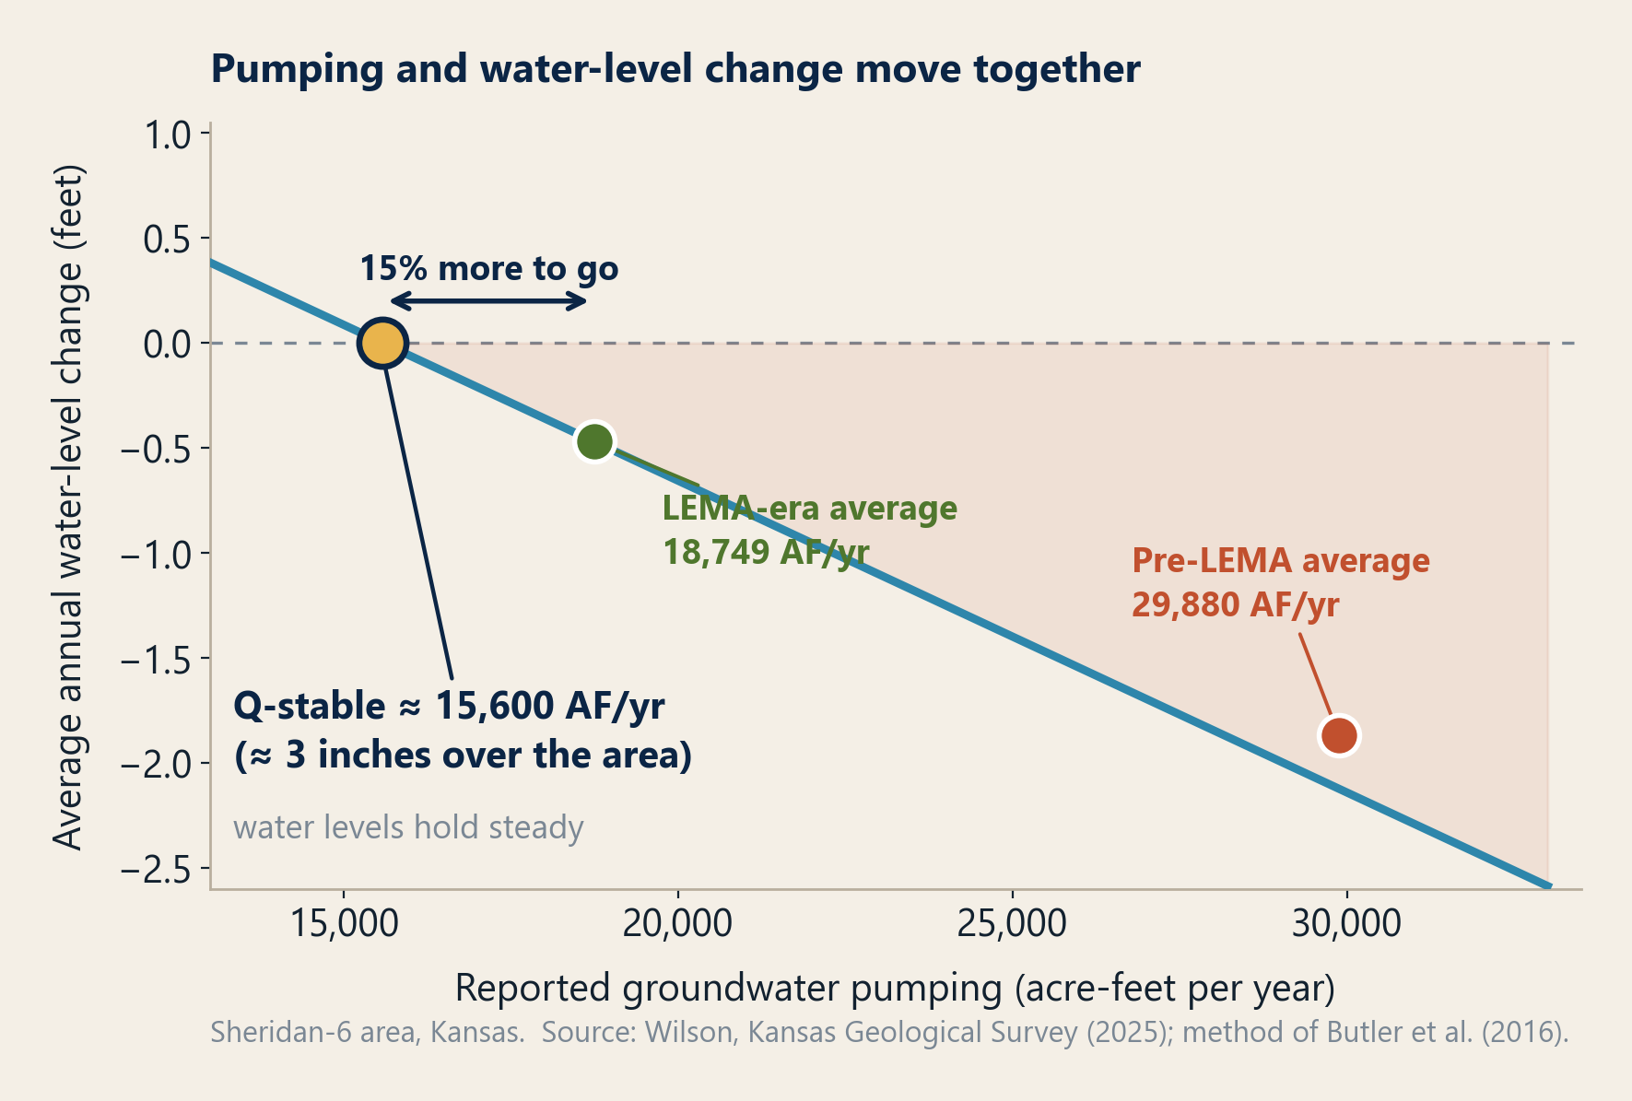
What Q-stable looks like when you measure it
Sheridan 6: pumping each year, plotted against what the water table did
Read it this way
Where the line crosses zero is Q-stable.
Everything to the right of it is drawdown.
The LEMA moved the dot
Closed about two-thirds of the gap to stability.
It is not there yet
Roughly 15% further to go.
8

Slide 9
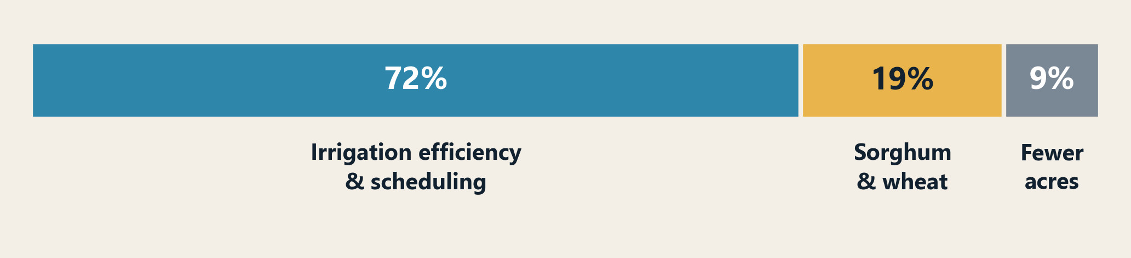
How did Sheridan 6 irrigators conserve?
Efficiency did the heavy lifting
Soil-moisture monitoring, scheduling, deficit irrigation.
Lower seed density to hold yield.
Crop mix moved at the margin
Some corn acres to sorghum and wheat.
Corn stayed dominant.
Fallowing was the last resort
Only 9% came from irrigating fewer acres.
The fear was “dry up the farm.” That is not what happened.
Source: Orduña Alegría et al. (2024), Nature Sustainability.
9

Slide 10
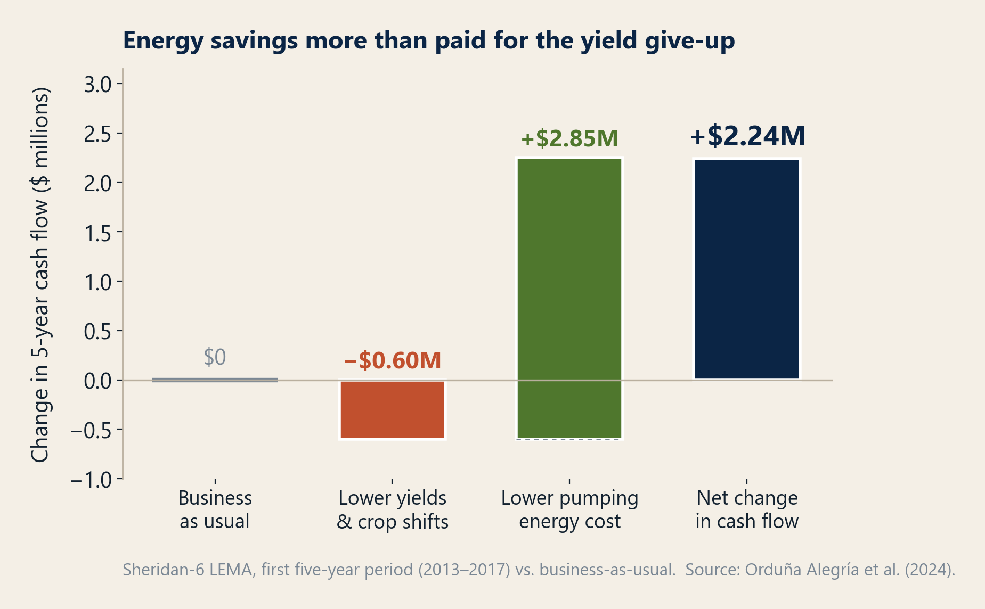
And they made money doing it
Change in five-year cash flow vs. a business-as-usual Sheridan 6
Why it worked: pumping is an energy bill
Energy is roughly 10% of corn production cost in western Kansas.
Lift water less often and that cost falls immediately.
The honest caveat
A cash-flow comparison from a small producer sample, in one area, over five years.
It shows the mechanism is real. It does not promise the same margin on every operation.
Source: Orduña Alegría et al. (2024), Nature Sustainability;
economic data from Golden (2018), Kansas Water Office.
10

Slide 11
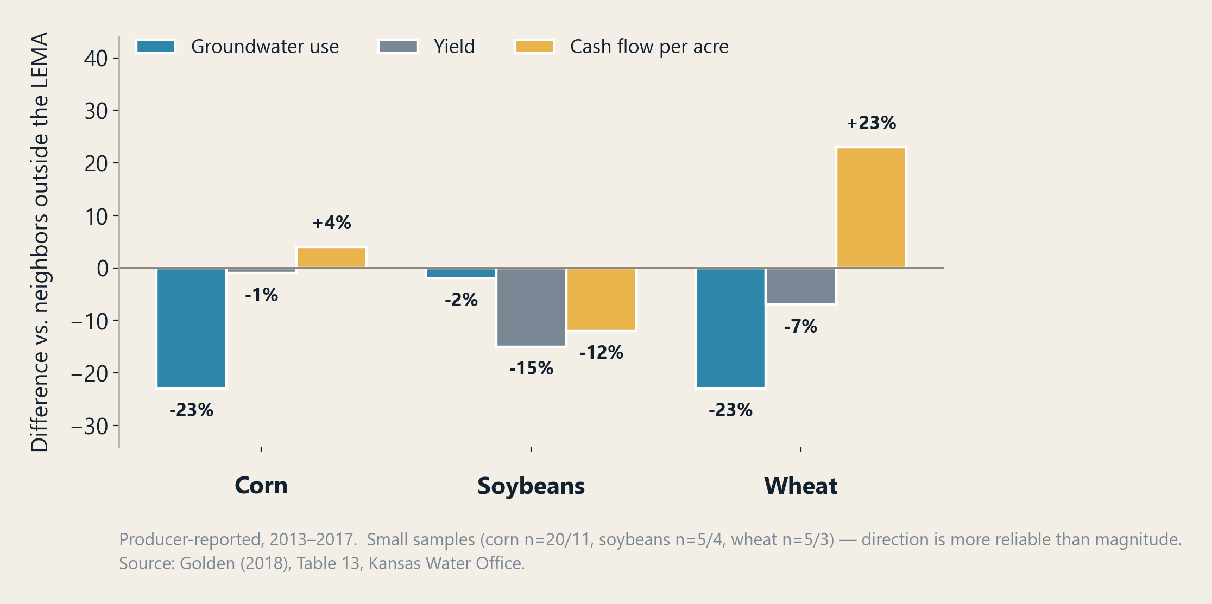
It was not uniform across crops
Sheridan 6 producers vs. their neighbors just outside the boundary
Corn and wheat came out ahead
Corn gave up 23% of its water for a 1% yield loss, and still earned slightly more per acre.
Soybeans did not
Yield fell 15% and cash flow fell 12% with it.
Averages hide real losers, which is the case for targeted support.
Cash flow per acre. Measured per inch of water applied, the same table shows corn +33%, wheat +58%, soybeans −11%.
11

Slide 12
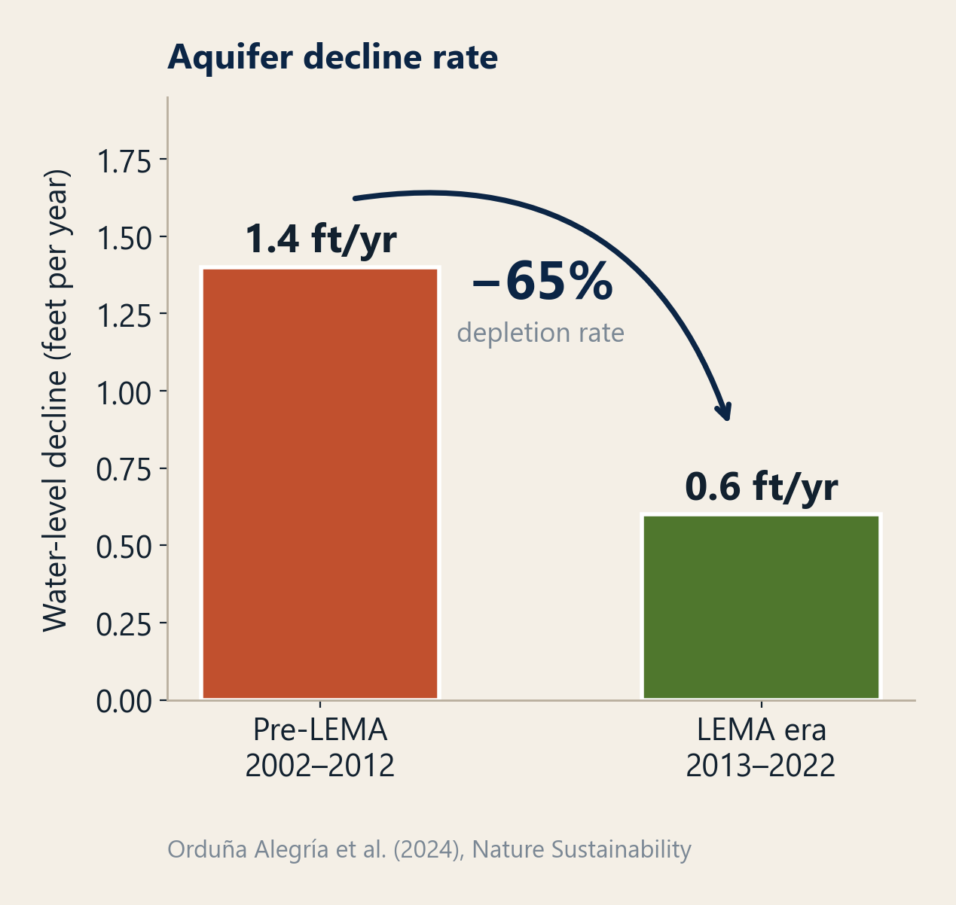
The aquifer responded
Water-level decline in Sheridan 6, before and during the LEMA
25–35 more years of usable aquifer life
The estimated payoff of a ~25% pumping cut, though the range carries real uncertainty.
The benefit stays local
KGS finds conservation benefits remain in the area that conserved. Coordination pays the coordinators.
But slowed, not stopped
Levels still fall; allocations were not tightened at renewal.
12

Slide 13
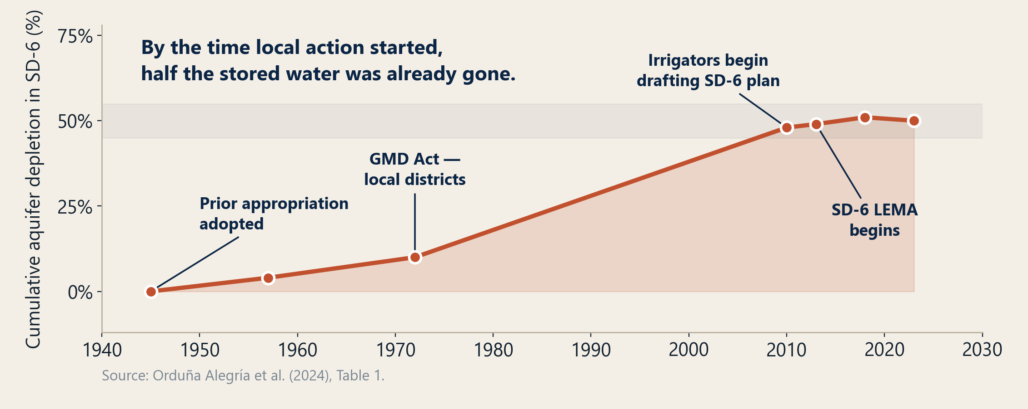
And they started at the halfway point
Cumulative depletion in Sheridan 6
Delay removes water you could have saved, and shrinks the toolkit left to save it with.
13

Slide 14
What it takes to farm with less water
ON THE FARM
Management
• Real scheduling, not calendar habit ¹ ²
– Up to 38% less applied water
• In-season soil-moisture probes ¹ ³
• Sorghum, wheat, shorter hybrids ⁴ ⁵ ⁶
– 5 to 6 in. per season, shorter hybrids *
• Adjusted seeding and residue ⁷ ⁸
– 28% less water for 5% less yield
– 2.5 to 3.5 in. held by full residue
• Net income per acre-inch, not bushels ⁹ ¹⁰ ¹¹
IN THE GROUND
Infrastructure
• Nozzles, drop lines, low pressure ¹² ¹³
– 15 to 30% less water and pumping energy *
• Mobile drip retrofits ¹⁴
– 35% less soil-water evaporation *
• Metering on every well ¹⁵ ¹⁶
– 10% alone, 20 to 40% with support
ACROSS THE AREA
Coordination
• Local rules, uniform enforcement ¹⁷ ¹⁸ ¹⁹
– 25% less extraction under the cap ¹⁶ ²⁵
– 72 / 19 / 9% efficiency, crops, acres ²
• Multi-year allocations ²⁰ ²¹
• Pooling across wells and farms ²¹ ²² ²³
• Carryover for over-conserving ²⁰ ²¹
• Measurement everyone trusts ¹⁶ ¹⁹ ²⁴
Efficiency improvements facilitate adaptation to tighter water use constraints.
Efficiency is how a producer meets a smaller allocation without losing the crop; it does not decide how much water the area uses. And applied water saved is not aquifer water saved: only 22% of the Sheridan 6 cut reached the net balance. ²⁵
* These estimates come from extension publications and are projections rather than observed results.
14

Slide 15
What producers are risking in the transition
The gap between “this works on average” and “I will go first”
Capital first, savings later
Nozzles, probes, drip and well work are paid up front. The cash-flow improvement shows up over seasons.
Yield risk lands in the worst year
Deficit irrigation is fine in an average year. Producers are underwriting the dry one.
A learning curve with real cost
The first years of tighter scheduling are when mistakes happen, and mistakes are measured in bushels.
Collateral and credit
Reduced water rights can read as a weaker balance sheet, right when the operation needs to borrow to adapt.
Landlord–tenant misalignment
Much of this ground is rented. Tenants make the water decisions; landlords hold the long-term asset.
Going first is the worst position
Without a binding, universal rule, unilateral restraint is a private cost. It looks like unilateral disarmament.
Every one of these is a timing or risk-bearing problem, not a disagreement about whether conservation is a good idea.
15

Slide 16
This is what financing and risk-sharing are for
Match the tool to the risk it actually removes
Solves: capital arrives before savings
Financing
• Low-cost capital for hardware and well work
• Repayment timed to the savings it creates
Solves: the private-cost, shared-benefit gap
Incentives
• Payment for verified reductions
• Pays the producer for value others capture
Solves: the learning curve
Technical assistance
• Agronomic support through tight seasons
• Scheduling, soil moisture, crop mix
Solves: the bad year, and going first
Risk-sharing
• Multi-year allocations and carryover
• Backstops; uniform rules for everyone
Why Sheridan 6 does not simply replicate itself
Unusually favorable conditions: visionary leadership, few water-right holders, a homogeneous area, metering already in place. Copies elsewhere in Kansas have produced mixed results; only one other LEMA shows a significant reduction. Where those conditions are weaker, capital and risk-sharing are what is missing.
16

Slide 17
Where this lands
Three things to take away
The target is knowable.
Q-stable turns “the aquifer is declining” into a local number a community can plan against. It is measured, not modeled.
The window is the scarce resource.
Every year of delay makes the required cut larger, the capital need bigger and the toolkit smaller, on four balance sheets at once.
And the transition is survivable: Sheridan 6 was profitable.
It cut depletion, bought an estimated 25–35 years of aquifer life, and added $2.24M in five-year cash flow, all from a 50%-depleted start.
Micah Cameron-Harp · Department of Agricultural Economics, Kansas State University
Structured review of water-use and profitability impacts

Slide 18
References (1 of 2)
Sources for the practices and savings estimates on slide 14
1. Datta, S., et al. (2023). Soil water sensors for irrigation scheduling in the United States: a systematic review of literature. Agricultural Water Management, 278.
2. Deines, J. M., et al. (2019). Quantifying irrigation adaptation strategies in response to stakeholder-driven groundwater management in the US High Plains Aquifer. Environmental Research Letters, 14, 044014.
3. Aguilar, J., Rogers, D., et al. Irrigation scheduling based on soil moisture sensors and evapotranspiration. Kansas Agricultural Experiment Station Research Reports.
4. Farmer-driven water conservation policy on the Ogallala aquifer reduces the environmental footprints of crop production (2025). Agricultural Water Management.
5. Ogallala Water CAP. Yield and soil water in wheat and sorghum rotations.
6. Texas A&M AgriLife Research (2014). Late corn planting with early-maturity hybrids, Texas High Plains.
7. Pre- and post-anthesis deficit irrigation of corn in the west-central Great Plains, 2018-2020 (ASABE). West-central and northwest Kansas.
8. Klocke, N. L., Currie, R. S., & Aiken, R. M. (2009). Soil water evaporation and crop residues. Transactions of the ASABE, 52(1), 103-110.
9. Kansas State University Extension, SRP536. Selecting irrigated crops for net income and water conservation.
10. Crop water productivity, applied water productivity and economic decision making (2022). Water, 14(10), 1598.
11. Golden, B. (2018). Monitoring the impacts of Sheridan County 6 LEMA, 2013-2017. Kansas State University Department of Agricultural Economics, for the Kansas Water Office.
12. Washington State University and Bonneville Power Administration. Low Energy Precision Application (LEPA) and Low Elevation Spray Application (LESA) fact sheets and field trials.
13. Cameron-Harp, M. V., & Hendricks, N. P. (2025). Efficiency and water use: dynamic effects of irrigation technology adoption. Journal of the Association of Environmental and Resource Economists, 12(2), 285-312.
18

Slide 19
References (2 of 2)
Sources for the practices and savings estimates on slide 14
14. Kisekka, I., Oker, T., et al. Mobile drip irrigation evaluation in corn. Kansas Agricultural Experiment Station Research Reports, 2(7).
15. Groundwater metering: revisiting a ubiquitous 'best practice' (2021). Hydrogeology Journal, 29.
16. Orduna Alegria, M. E., Zipper, S., et al. (2024). Unlocking aquifer sustainability through irrigator-driven groundwater conservation. Nature Sustainability.
17. Perez-Quesada, G., & Hendricks, N. P. (2021). Lessons from local governance and collective action efforts to manage irrigation withdrawals in Kansas. Agricultural Water Management, 247, 106736.
18. Zwickle, A., Feltman, B. C., Brady, A. J., Kendall, A. D., & Hyndman, D. W. (2021). Sustainable irrigation through local collaborative governance: evidence for a structural fix in Kansas. Environmental Science & Policy, 124, 517-526.
19. Ostrom, E. (1990). Governing the Commons: The Evolution of Institutions for Collective Action. Cambridge University Press.
20. Kansas Department of Agriculture, Division of Water Resources. Multi-Year Flex Accounts (K.S.A. 82a-736).
21. Groundwater Management District 4 and Kansas DWR. Sheridan 6 LEMA Order of Designation (2013), carryover provision added 7 November 2017, and the 2018 and 2022 renewals.
22. Kansas Department of Agriculture, Division of Water Resources. Water Conservation Areas (WCAs).
23. Market-oriented solutions for groundwater commons through collective action (2023). Environmental Research Letters, 18.
24. Zipper, S., et al. (2023). Moving from measurement to governance of shared groundwater resources. Nature Water, 1, 30-36.
25. Deines, J. M., et al. (2021). Combining remote sensing and crop models to assess the sustainability of stakeholder-driven groundwater management in the US High Plains Aquifer. Water Resources Research, 57, e2020WR027756.
19

