Slide 1
What does pre-planting soil moisture tell us about final corn yields?
Micah Cameron-Harp, Parker Vulgamore, Jennifer Ifft, and Jesse Tack
Risk and Profit Conference
August 21 & 22, 2025

Slide 2
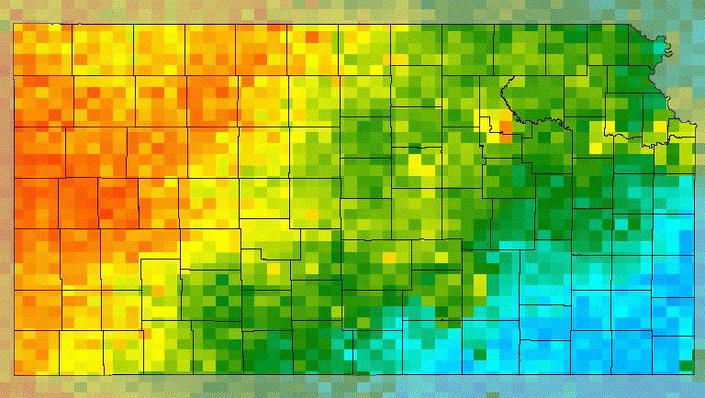
Daily Soil Moisture
January 1st to March 15^{th,} 2021
Data source: NASA-USDA Enhanced SMAP

Slide 3
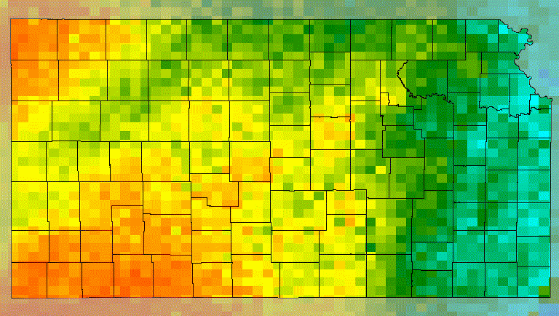
Daily Soil Moisture
January 1st to March 15^{th,} 2022
Data source: NASA-USDA Enhanced SMAP

Slide 4

Are decisions made based on early season soil moisture information supported by measurable impacts on corn yields?

Slide 5
Data Sources
Yield Data: USDA Risk Management Agency (1990-2022)
Precise county yield records
Ability to control for irrigation status
Soil Moisture Data: NASA SPoRT-LIS (1km² daily measurements)
High-resolution standardized moisture data
Longer time series than alternatives
Planting dates: Deines et al. (2023)
estimate county-level dates
Vary year-to-year
Use 30 days before 10% of corn planted

Slide 6
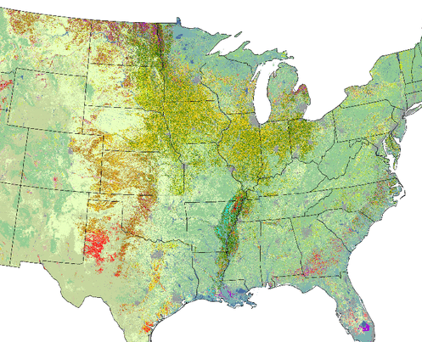
Methods: Scaling Soil Moisture Data to the County Level
Step 1
Create crop masks
Used USDA NASS CDL (2002–2021)
Kept grid cells that grew corn, wheat, or soybeans in ≥ 50% years
Output: binary map of “consistently cropped” land
Step 2
Apply to soil moisture
Converted volumetric SM to RSM
Step 3
Aggregate to counties
Used spatially-weighted median to account for partial grid cell overlap w/ counties
Example: grid cell 50% in county = 50% weight
Multiplied by crop mask → keeps only relevant cropland pixels

Slide 7
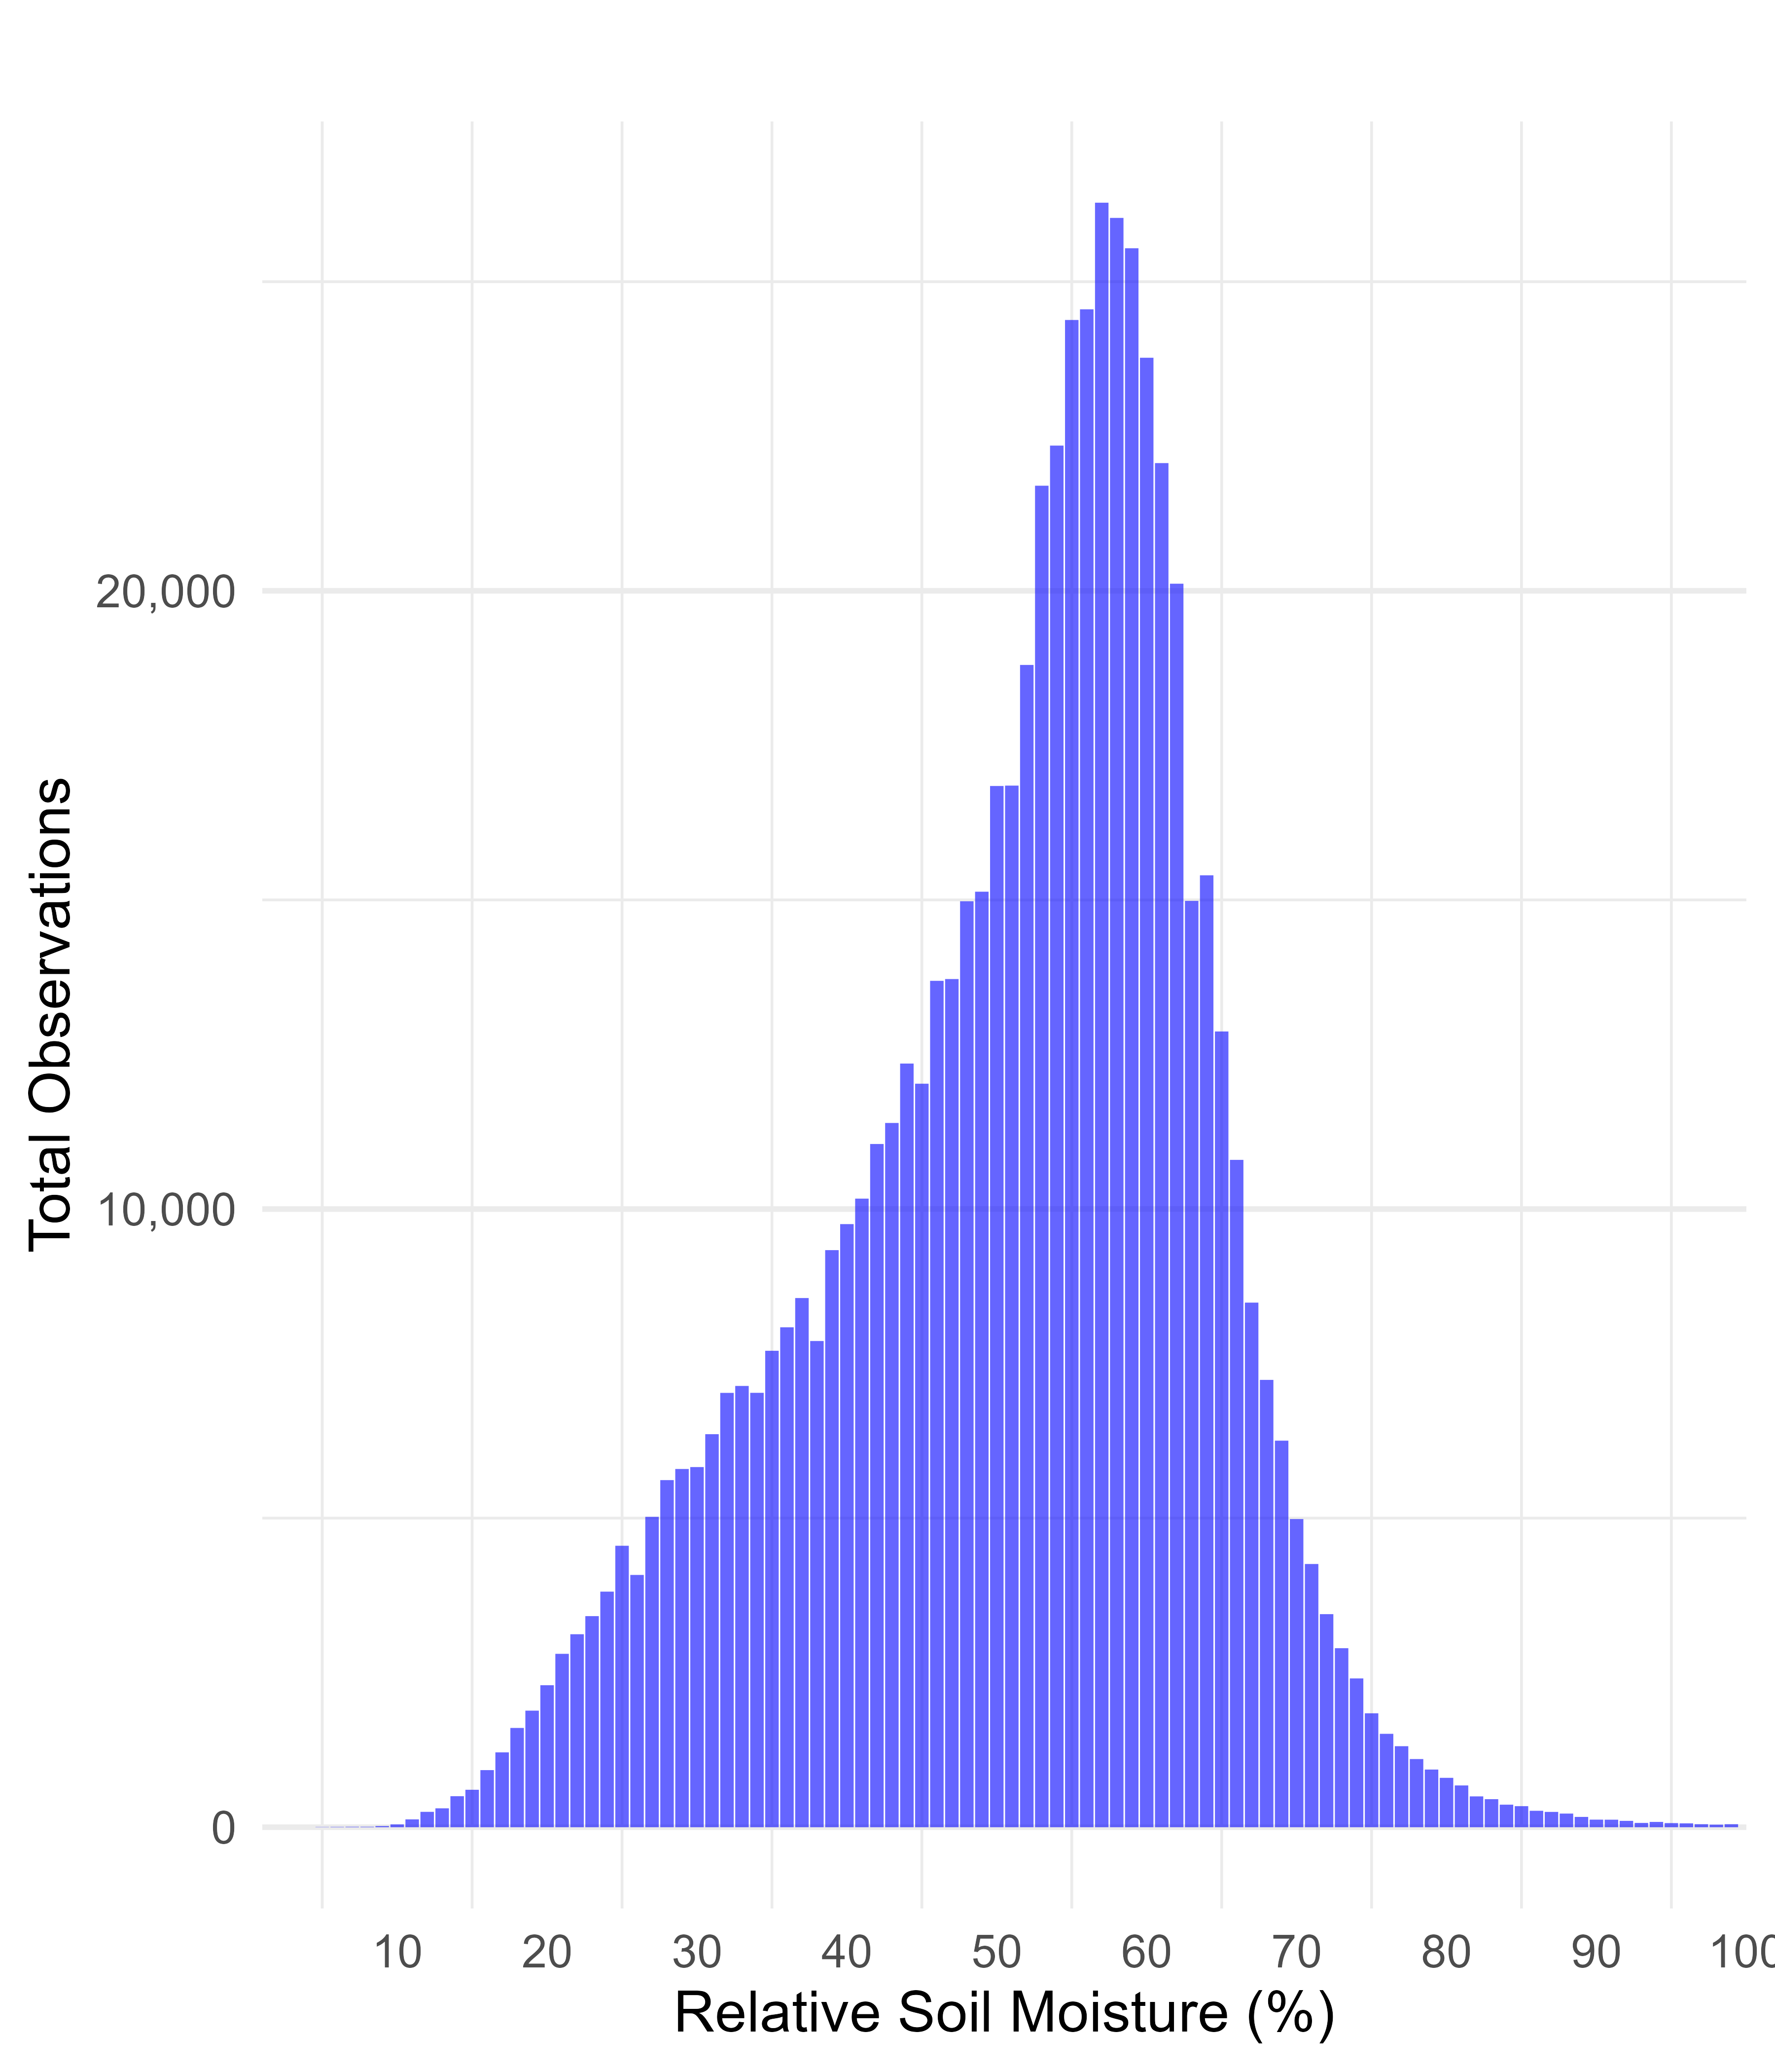
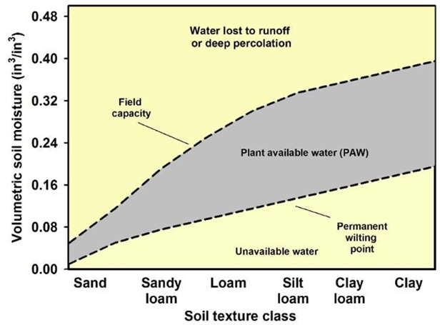
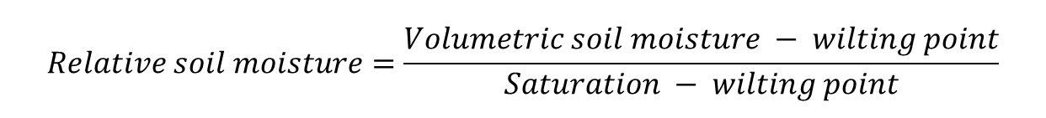
Relative Soil Moisture (RSM) Data
$$Relative soil moisture=\frac{Volumetric soil moisture − wilting point}{Saturation − wilting point}$$
Interpretation:
  0 = wilting point
  1 = saturation
Stress thresholds:
  Below 0.2: drought conditions
  Above 0.8: excess moisture stress

Slide 8

Methodology: Non-Parametric Soil Moisture Exposure Model

Slide 9
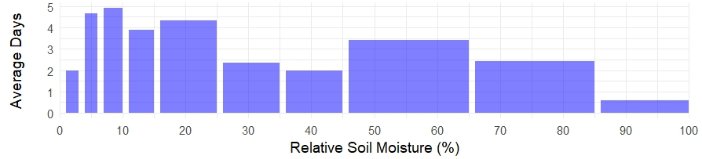
Specifying Exposure Bins
Why Bin Selection Matters:
  Too many bins/regressors may cause overfitting (Schwarz, 1978).
  Too few bins may overlook important nonlinear effects.
Bin Definition and Calculation:
  Grouped into 100 bins, each representing a 1% increment of Relative Soil Moisture (RSM).
Data-Driven Bin Selection Process:
  K-fold cross validation procedure.

Slide 10
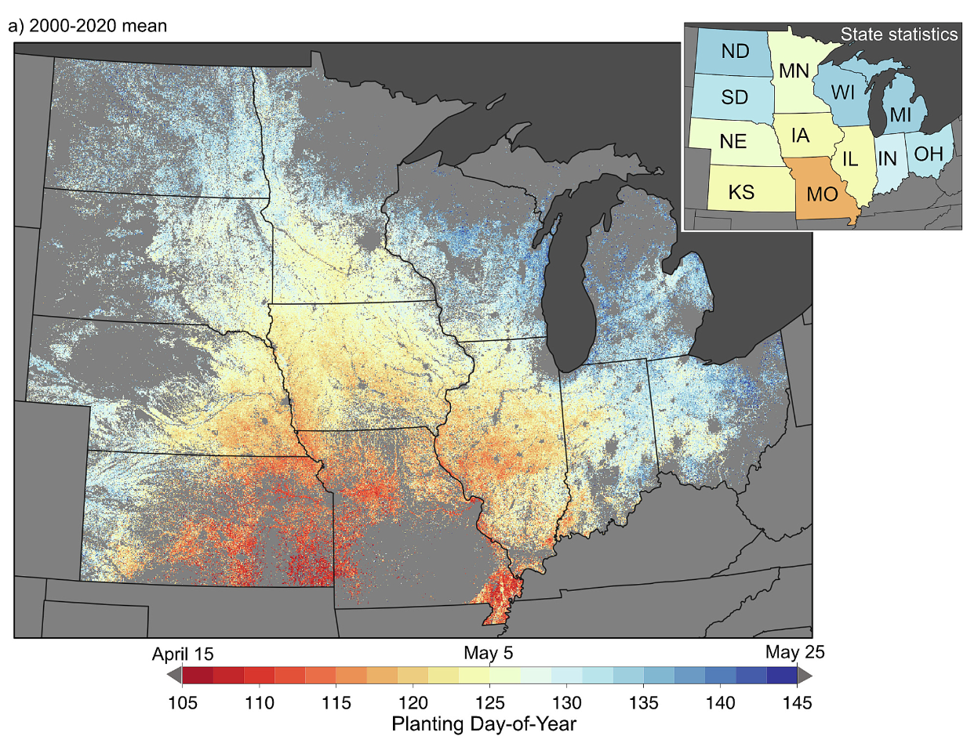
“Early Season” Definition
Use dates from Deines et al. (2023).
30 days prior to the date when 10% of the corn crop is planted.

Slide 11
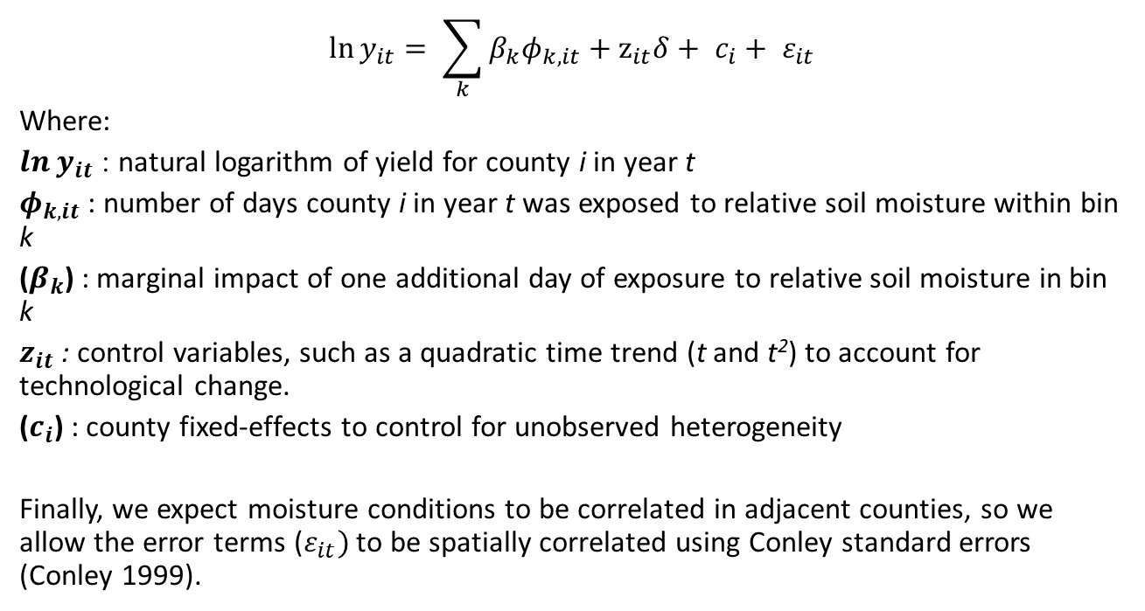
Regression Model Specification
$$\ln{y_{it}}= \sum_{k}{β_{k}φ_{k,it}​}+z_{it}δ+ c_{i}+ ε_{it}$$
Where:
$\ln{y_{it}}$ : natural logarithm of yield for county i in year t
$φ_{k,it}$ : number of days county i in year t was exposed to relative soil moisture within bin k
($β_{k}$) : marginal impact of one additional day of exposure to relative soil moisture in bin k
$z_{it}$ : control variables, such as a quadratic time trend (t and t²) to account for technological change.
($c_{i}$) : county fixed-effects to control for unobserved heterogeneity
Finally, we expect moisture conditions to be correlated in adjacent counties, so we allow the error terms ($ε_{it})$ to be spatially correlated using Conley standard errors (Conley 1999).

Slide 12
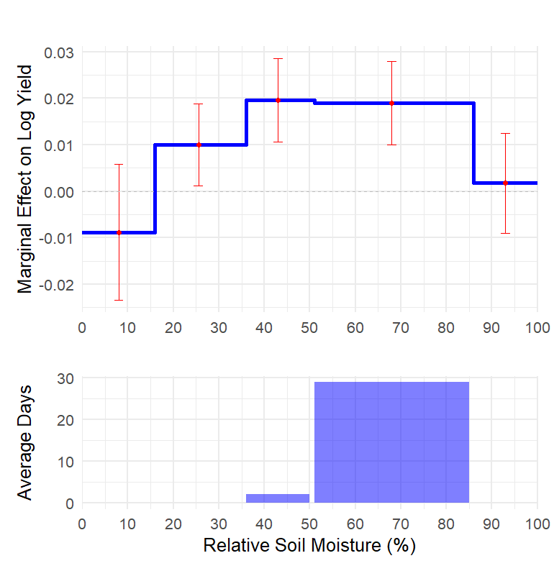
Results: National Model
What Do the Coefficients Mean?
Each coefficient represents the effect of one additional day spent within a specific soil moisture bin.
Overall Insight:
Exposure to very low soil moisture (1–15%) reduces yields.
  An additional day reduces yield by 1%.
Typical, intermediate levels increase yields (16-85%).
Evidence that high soil moisture levels may be detrimental.

Slide 13
Results: National Model
Variable | Estimate | Standard Error | t Value | p Value | Significance
SM 1-15% | -0.0088 | 0.0075 | -1.1746 | 0.240
SM 16-35% | 0.0100 | 0.0045 | 2.2111 | 0.027 | *
SM 36-50% | 0.0196 | 0.0046 | 4.2949 | <0.001 | ***
SM 51-85% | 0.0190 | 0.0046 | 4.1532 | <0.001 | ***
SM 86-100% | 0.0018 | 0.0055 | 0.3248 | 0.745
time | 0.0097 | 0.0015 | 6.2339 | <0.001 | ***
time² | 0.0007 | 0.0001 | 11.4042 | <0.001 | ***
Observations | 21495
Adj. R-squared | 0.5535
Standard-errors | Conley (50km)
Fixed effects | County: 0
RMSE | 0.37566

Slide 14
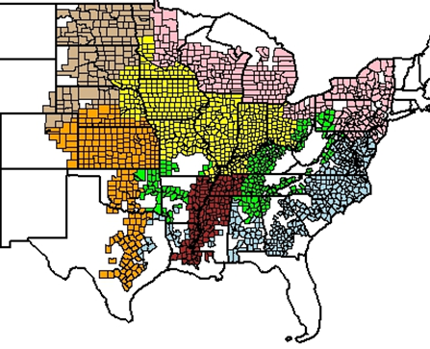
Key Findings: Spatial Heterogeneity
USDA Economic Research Service (ERS) Farm Resource Regions
  Robustness checks
Effects vary significantly across regions:
  High rainfall areas benefit from drier early season conditions
  Drought-prone areas suffer from dry conditions

Slide 15
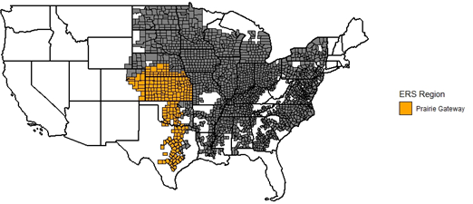
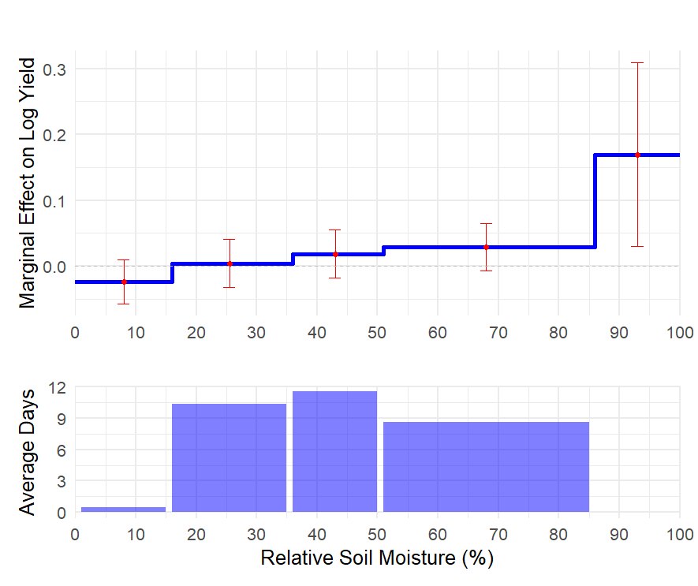
Prairie Gateway

Slide 16
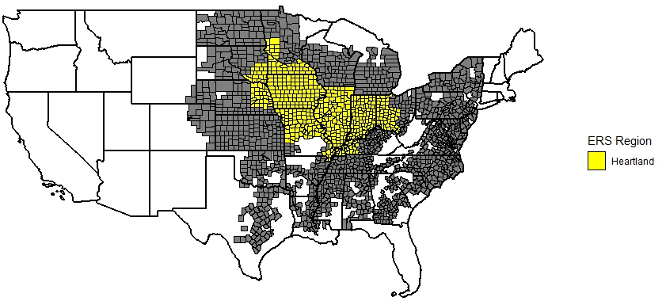
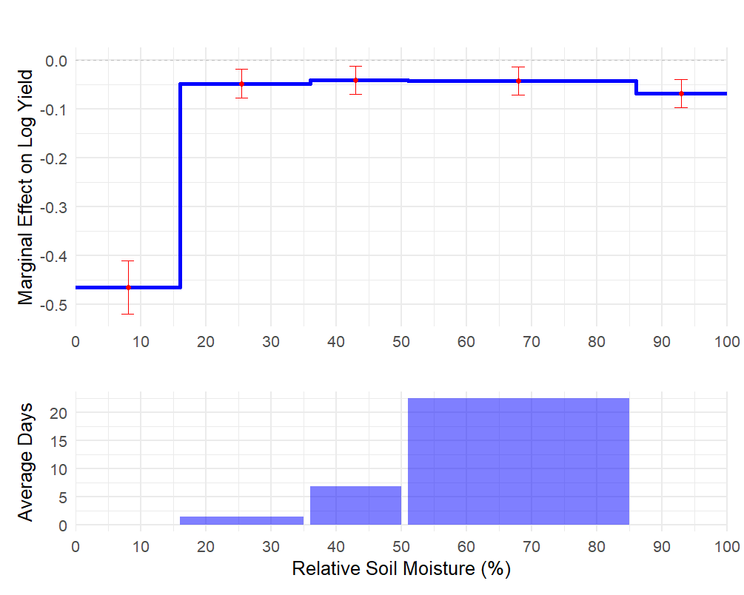
Heartland

Slide 17
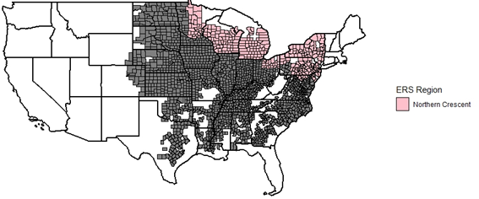
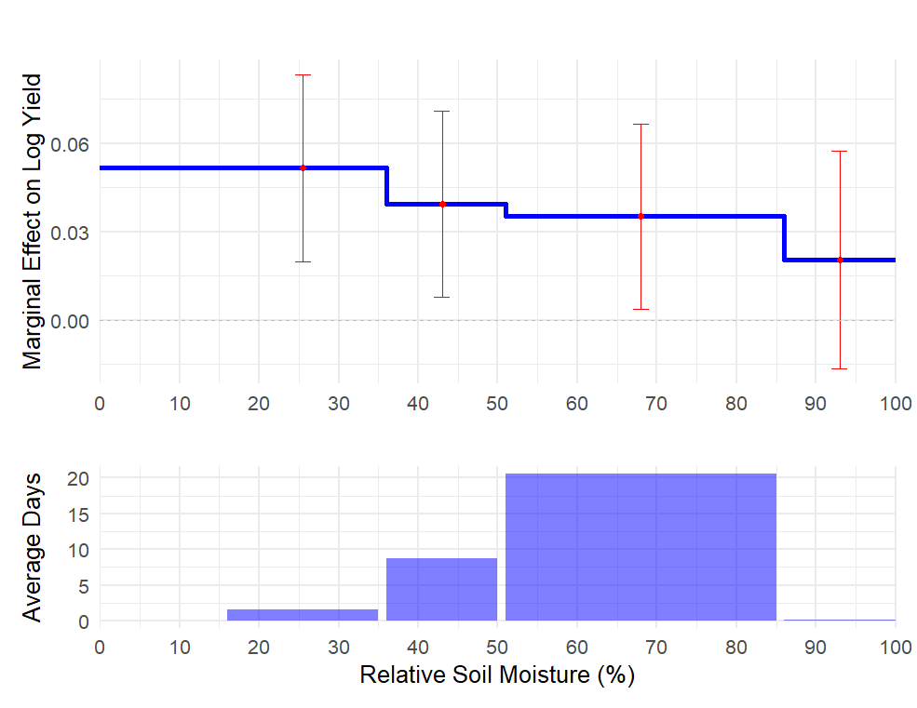
Northern Crescent

Slide 18
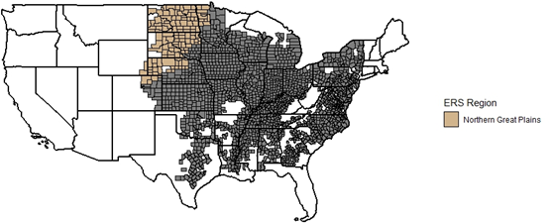
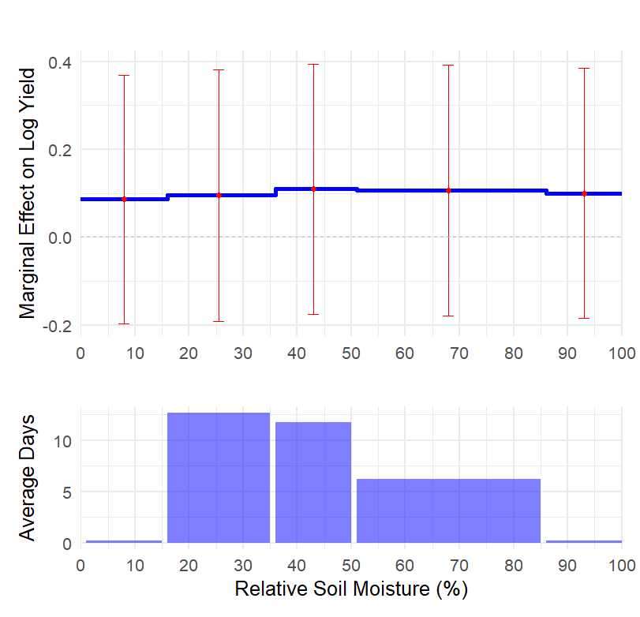
Northern Great Plains

Slide 19

Summary and Contributions
Key Findings:
Strong evidence of a nonlinear relationship between early season soil moisture and yield outcomes.
Clear indication of regional heterogeneity
Demonstrated method's effectiveness in capturing critical moisture thresholds without imposing restrictive assumptions.
So What?
As more data becomes available, we can better predict differences between local and national production.
Accurate models facilitate better marketing and planting decisions going forward.

Slide 20
Thank you!
mcameronharp@ksu.edu
mcameronharp.com

