Slide 1

Carbon Credit Markets: Current Opportunities and Future Prospects
Micah Cameron-Harp and Dr. Nathan P. Hendricks
Department of Agricultural Economics
Kansas State University

Slide 2
Outline
Intro
  What are carbon credits/markets?
  What impacts the price of a carbon credit?
Determinants of potential payments
Return on investment
Current opportunities in KS
  What are the pros and cons of each program?
Future outlook

Slide 3
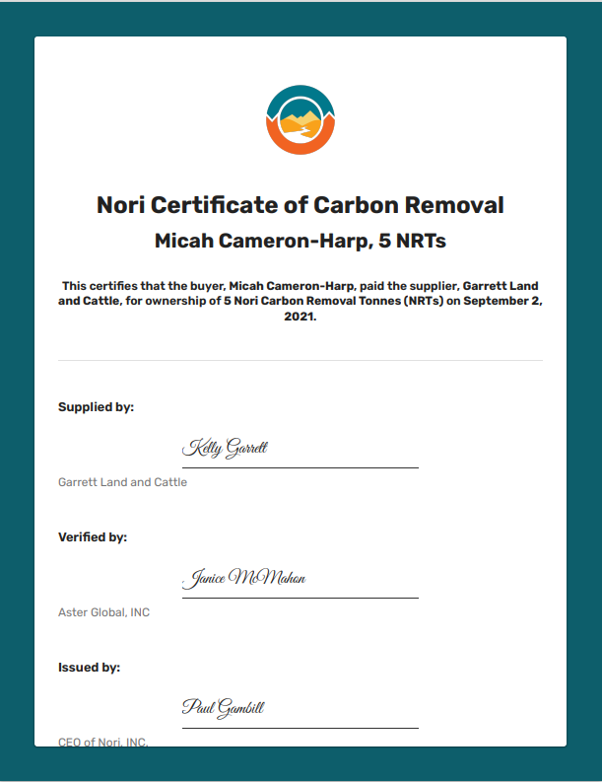
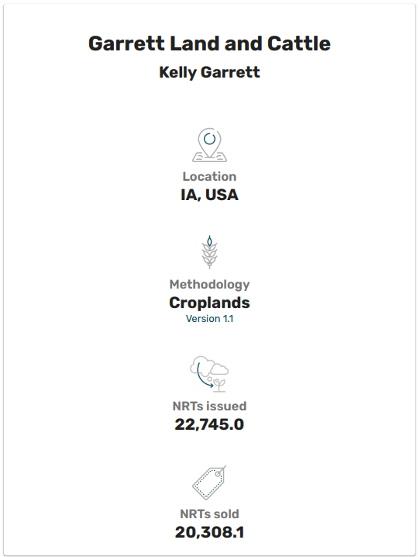
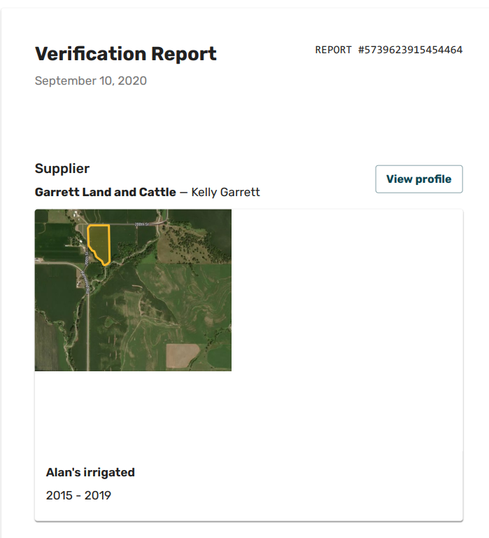
Example carbon credits
Notes:
https://www.bloomberg.com/news/features/2021-08-04/africa-s-climate-data-has-gaps-can-old-books-help

Slide 4
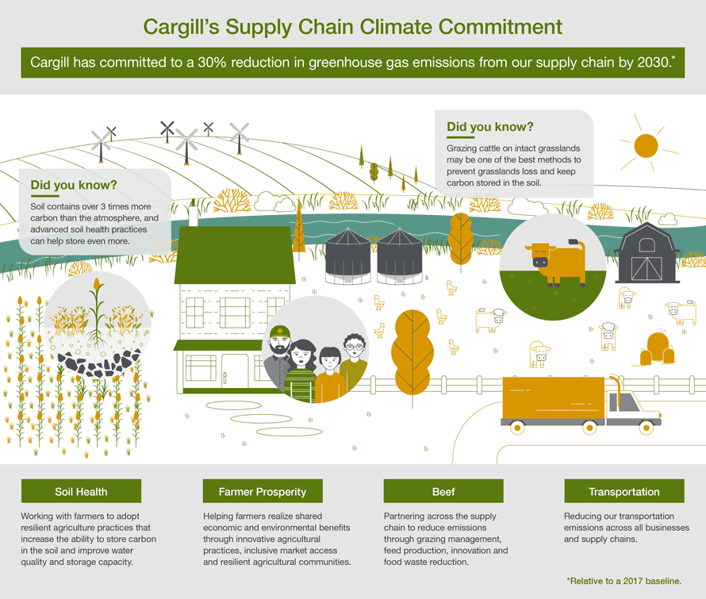
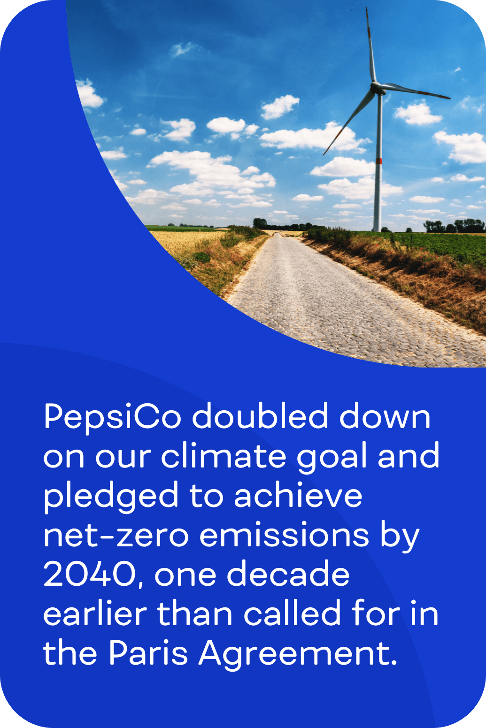

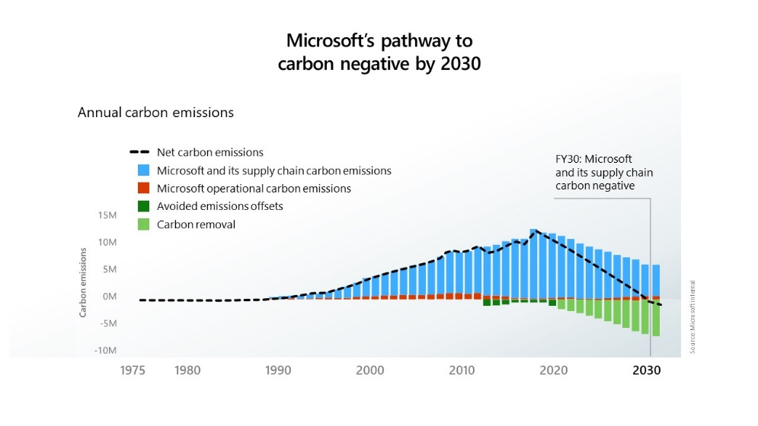
Who’s paying for carbon credits and why?
Corporate Climate Pledges
Cargill
PepsiCo
Microsoft
Source
Source
Source

Slide 5
Agricultural Carbon Credit Market Structure
Sellers/
Producers
Operator
Implement a practice that sequesters carbon in the soil or reduces greenhouse gas emissions.
Buyers
McDonald’s
Pepsi
Microsoft
Individuals
Buy carbon credits to offset their emissions.
Intermediary
Nori
Indigo
Ecosystem Services Market Consortium
Matches buyers with sellers and verifies the carbon offset.
Landowner approval required for leased land

Slide 6
Market trajectory
How big is current demand?
  93 million carbon credits purchased in 2020, around 156 million in 2021
  At $15/credit, these figures represent roughly 1.4 and 2.3 billion dollars in sales (Indigo’s agricultural credits now sell for ~$40 a piece)
What about supply?
  Current supply of carbon credits (~630 million metric tons) is less than one tenth of annual U.S. emissions (~8.1 billion metric tons)
Of the 1.3 million metric tons (MT) of offsets Microsoft contracted for 2021, almost 200,000 metric tons are from soil carbon sequestration
Notes:
https://www.bloomberg.com/news/features/2021-08-04/africa-s-climate-data-has-gaps-can-old-books-help
https://www.wsj.com/articles/carbon-credit-surplus-could-soon-turn-to-shortage-11663968204

Slide 7
Quality assurance issues for carbon credits.
Additionality
Permanence
Leakage
Uncertainty

Slide 8


What determines carbon credit quality?
Before Enrollment
After Enrollment
Additionality
Permanence
Leakage
Uncertainty

Slide 9




What determines carbon credit quality?
Conventional
tillage
No-till
Conventional
tillage
Additionality
Permanence
Leakage
Uncertainty

Slide 10




What determines carbon credit quality?
Additionality
Permanence
Leakage
Uncertainty

Slide 11


What determines carbon credit quality?
Additionality
Permanence
Leakage
Uncertainty
How much carbon does cover-cropping sequester?
+.15 tC/ acre /year?
+.22 tC/acre/year?

Slide 12
Determinants of payments
Practice Adopted | Site conditions and management | Carbon sequestration estimate | Estimated payment per acre (assuming $15/MT CO2e)
No-till | Warm and dry climate Loamy, Silty, or Clayey soil | 0.26 MT/acre/year | $4.40/acre/year
No-till | Warm and dry climate Sandy soil | 0.23 MT/acre/year | $3.85/acre/year
Cover Cropping with NT | Hesston, KS Late soybean in winter-wheat/sorghum | .5 tC/acre/year | $8.24/acre/year
Cover Cropping with NT | Hesston, KS Sunn hemp in winter wheat/sorghum | .73 MT/acre/year | $12.24/acre/year
Notes:
.1 tC/hectare per year no-till results from Ogle, S.M., Alsaker, C., Baldock, J. et al. Climate and Soil Characteristics Determine Where No-Till Management Can Store Carbon in Soils and Mitigate Greenhouse Gas Emissions. Sci Rep 9, 11665 (2019). https://doi.org/10.1038/s41598-019-47861-7
Cover crop in no-till results from Blanco-Canqui, H., M.M. Mikha, D.R. Presley, and M.M. Claassen. 2011. Addition of cover crops enhances no-till potential for improving soil physical properties. Soil Sci. Soc. Am. J. 75:1471– 1482. doi:10.2136/sssaj2010.0430

Slide 13
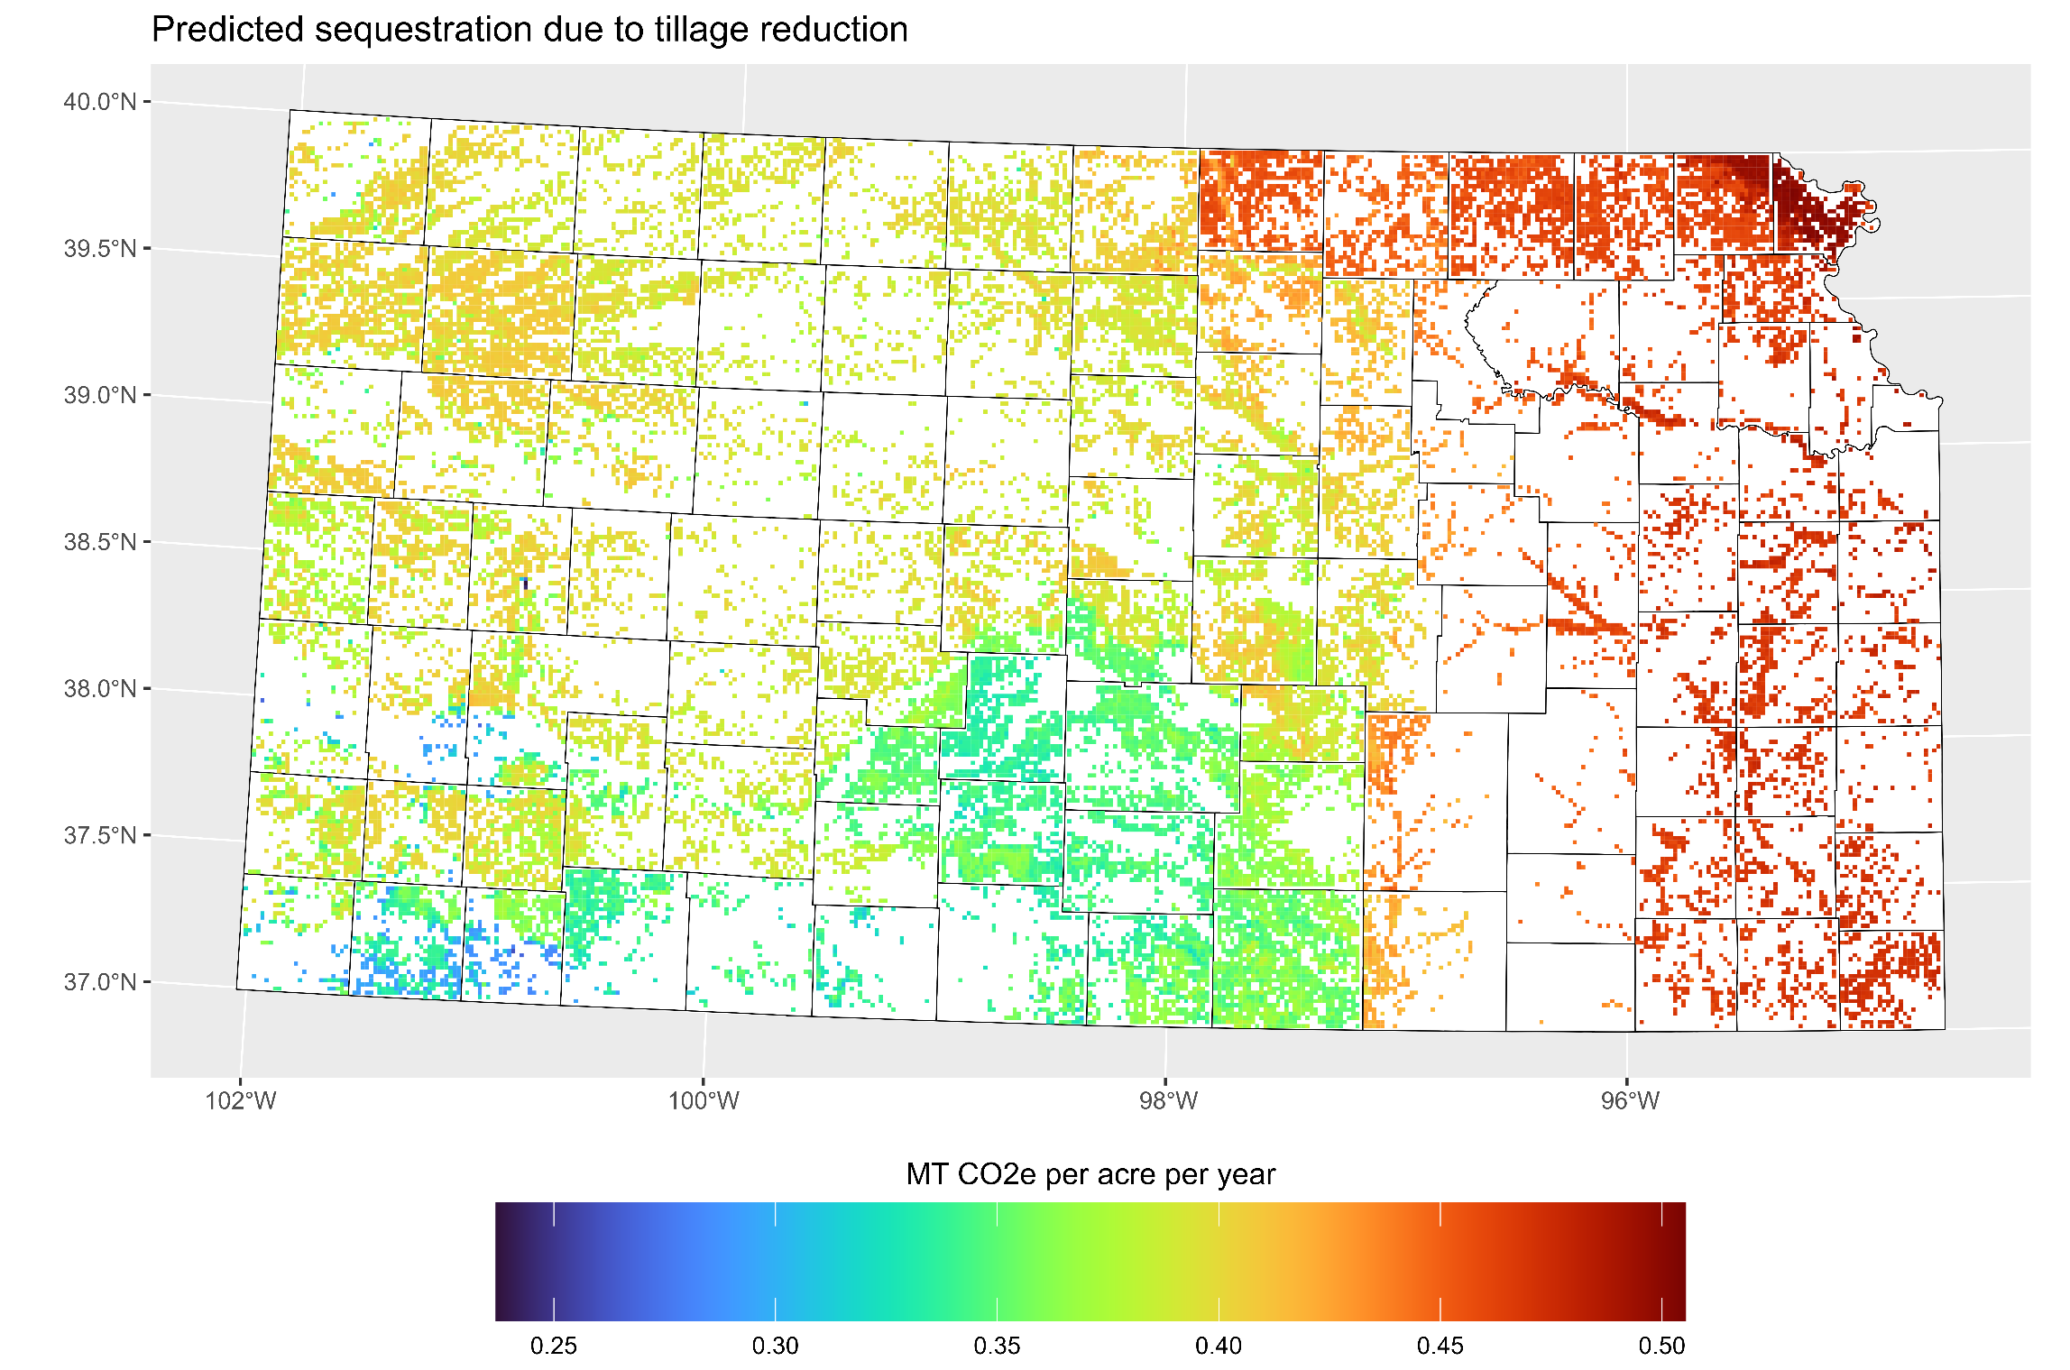

Slide 14
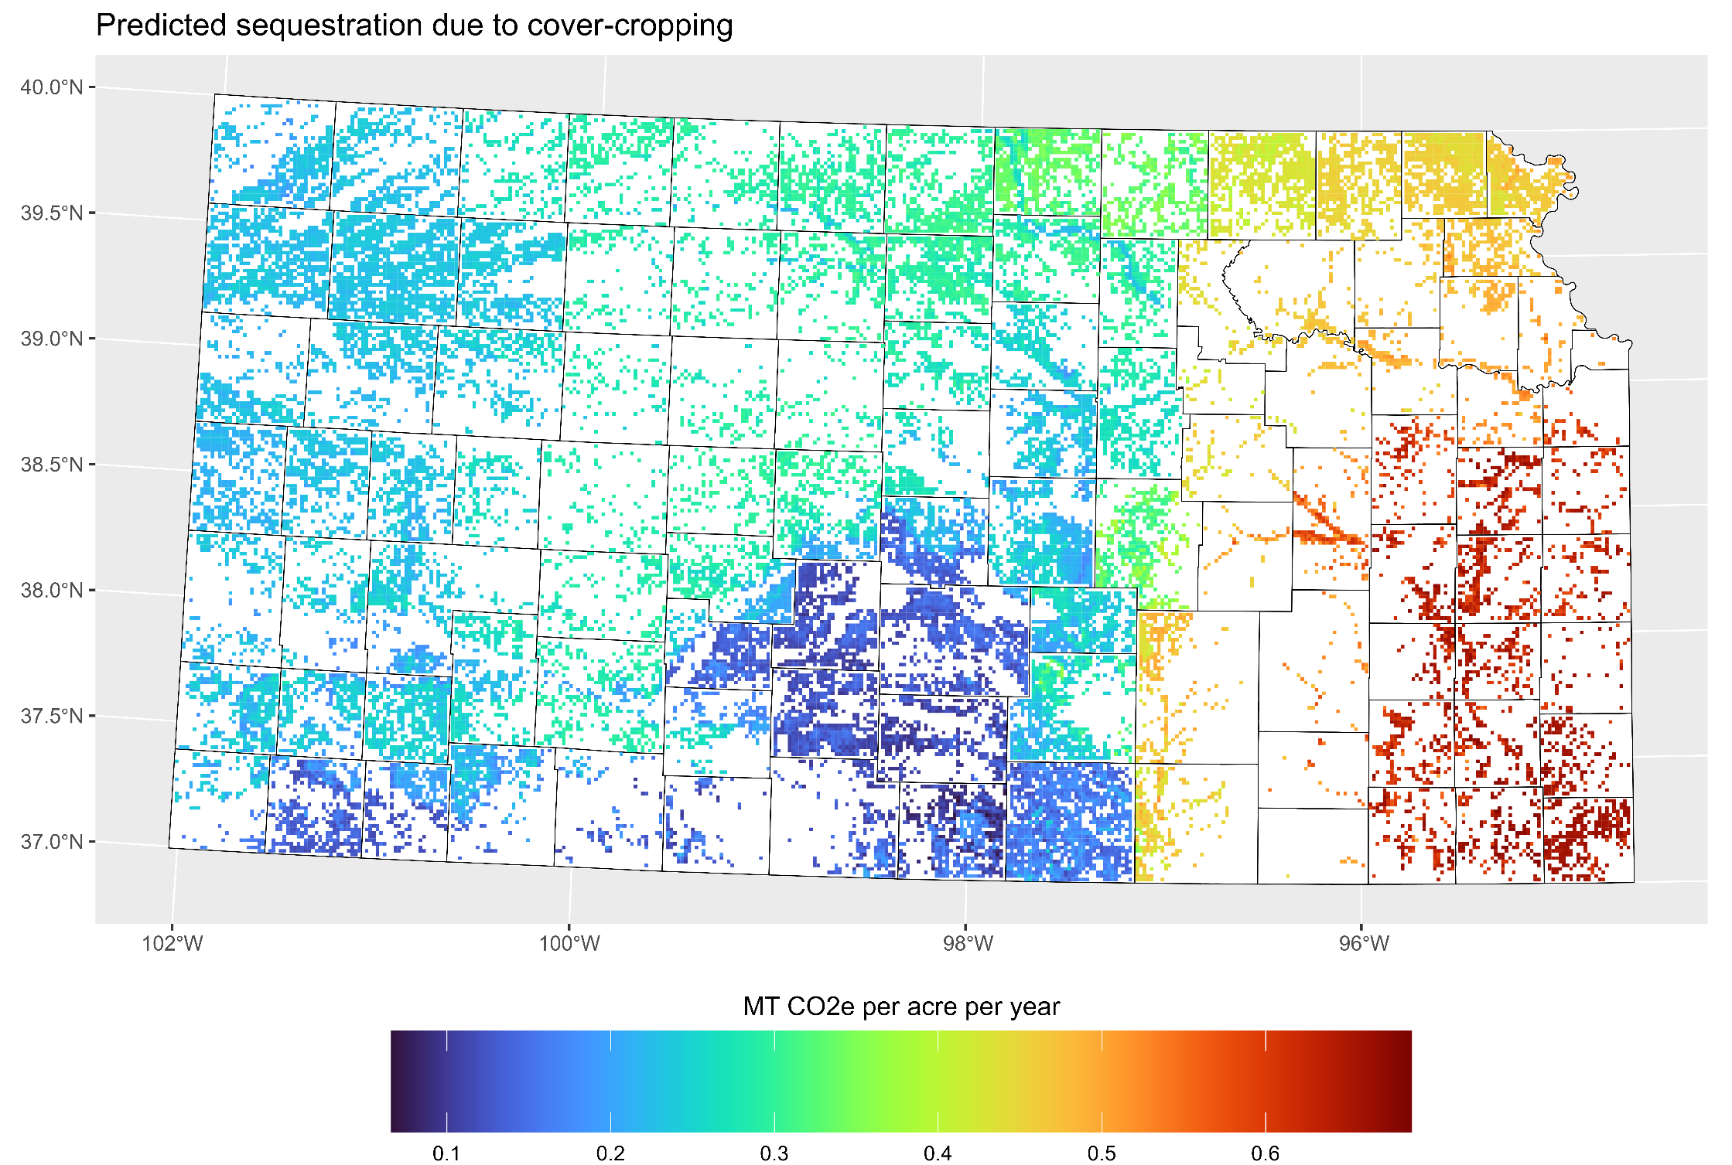

Slide 15
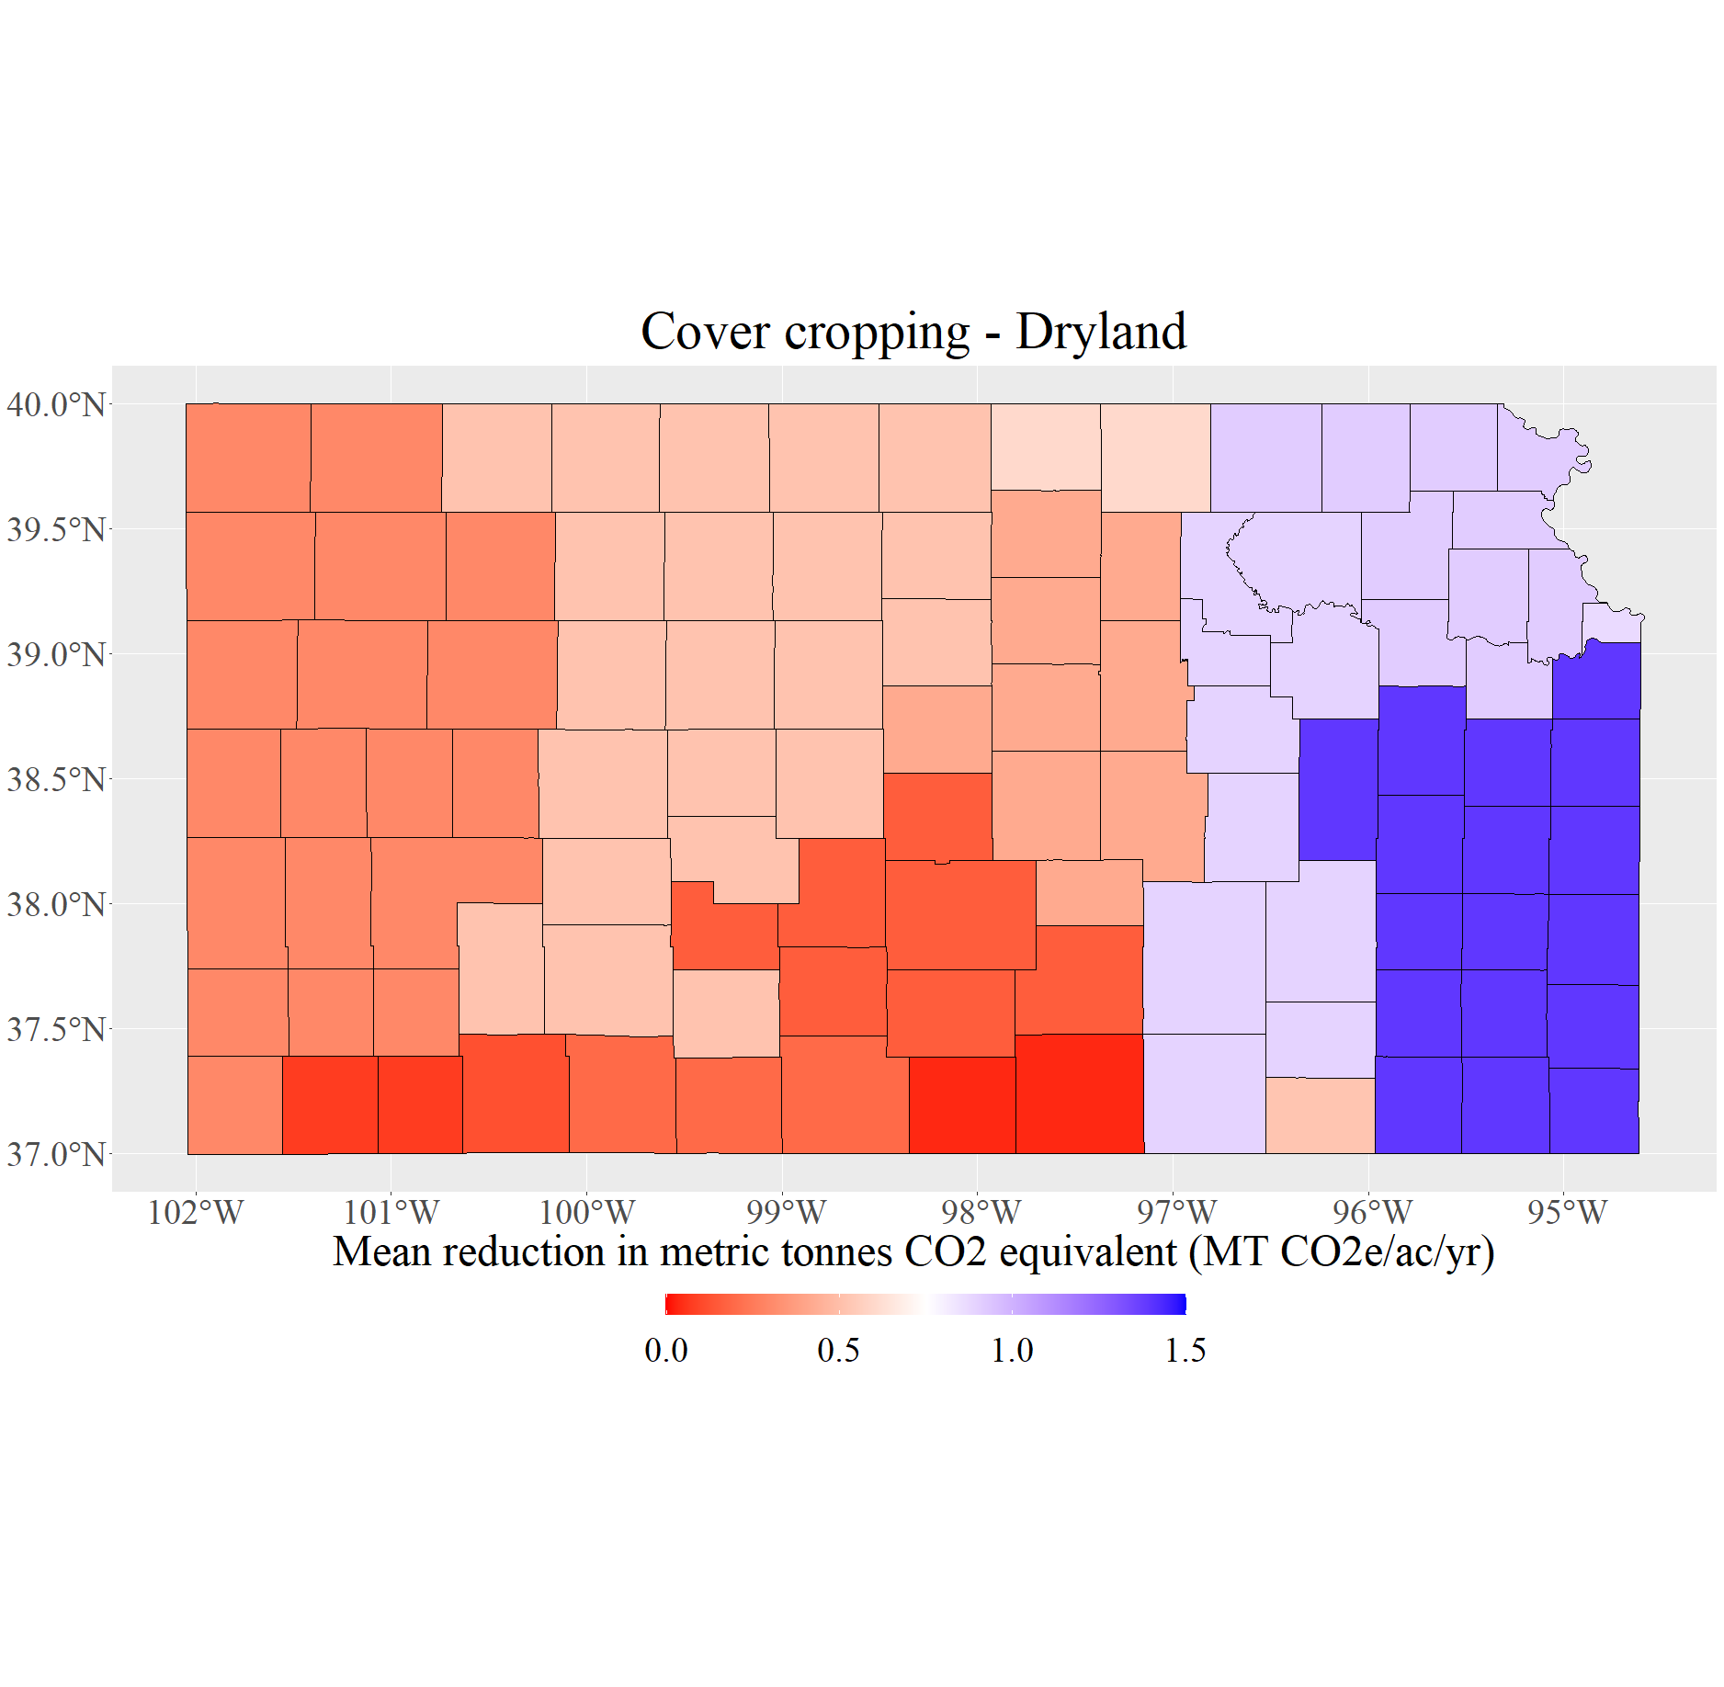
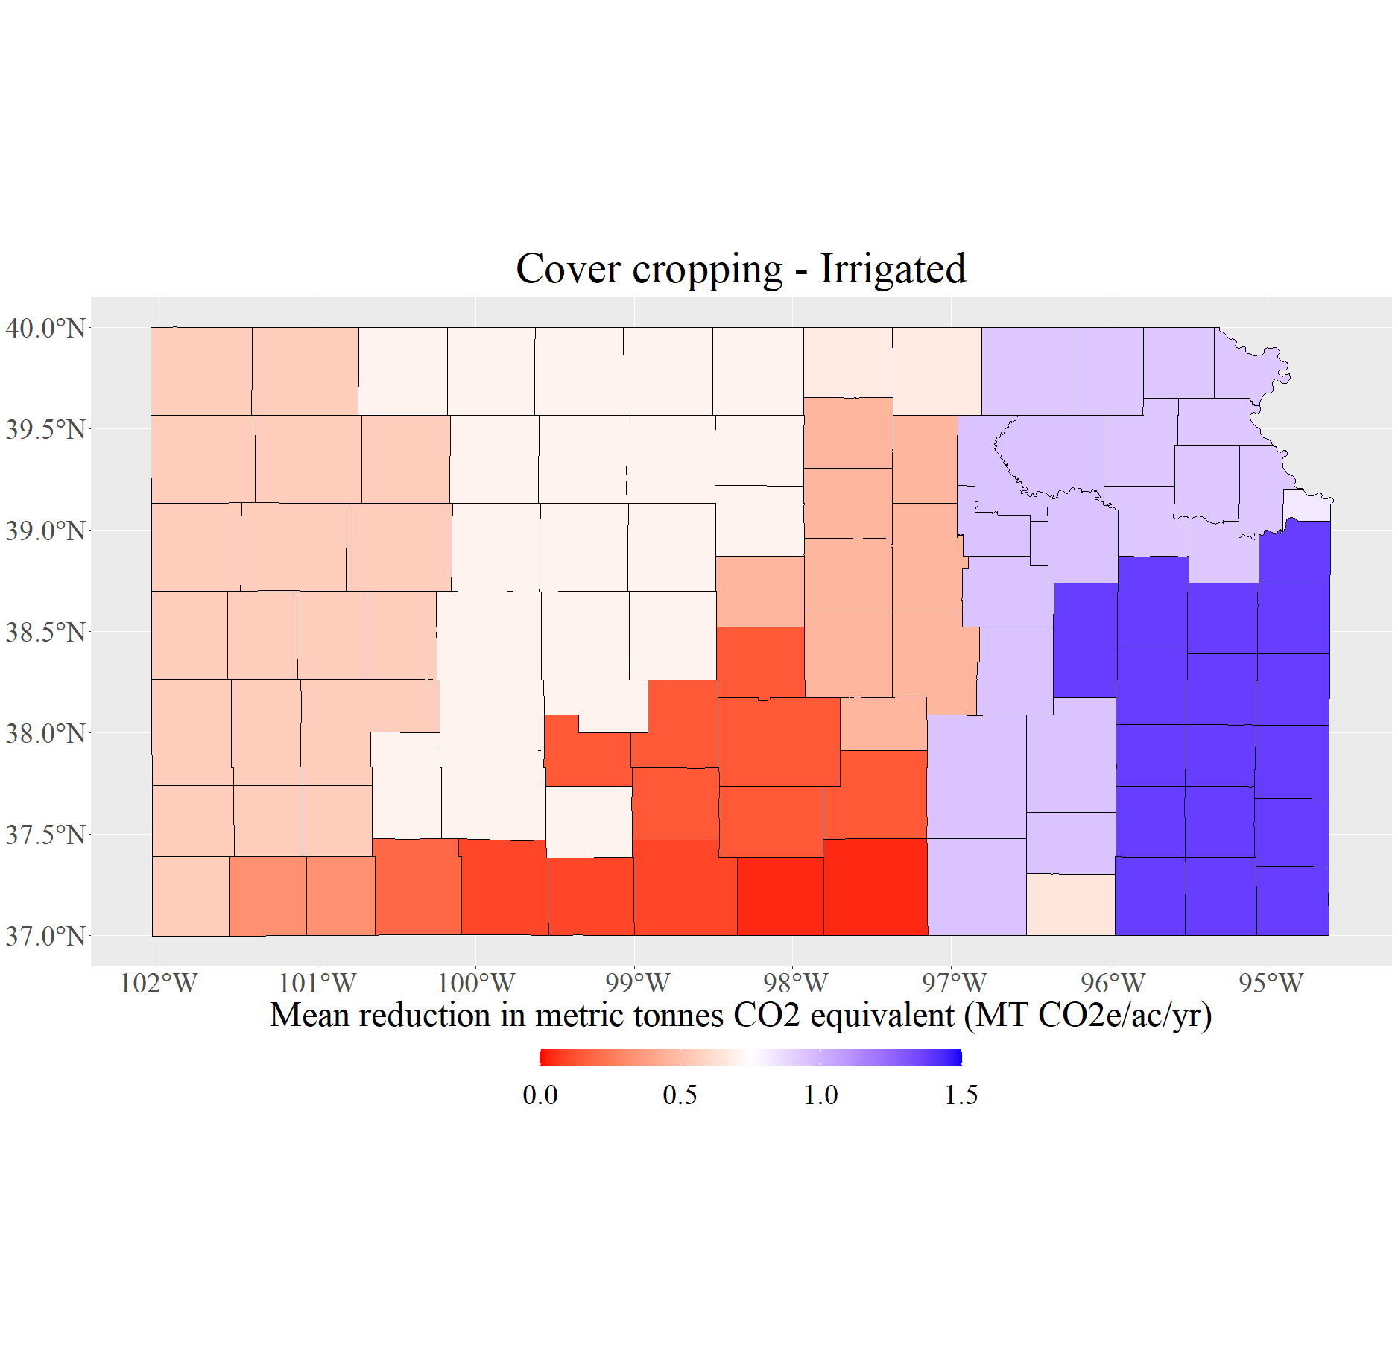
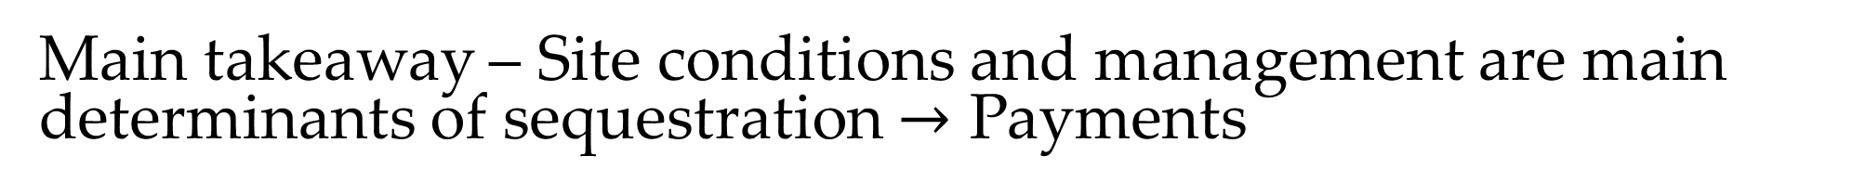
Main takeaway – Site conditions and management are main determinants of sequestration $→$ Payments
Dollars/acre/year
Dollars/acre/year
0
$11.25
$22.50
0
$11.25
$22.50
Ellsworth County, KS Data
Dryland |  |  | Irrigated
Minimum | Average | Maximum | Minimum | Average | Maximum
$0/acre/year | $6.3/acre/year | $30.15/acre/year | $0/acre/year | $7.05/acre/year | $32.25/acre/year
-0.50 MT CO2e/acre/year | 0.42 MT CO2e/acre/year | 2.01 MT CO2e/acre/year | -0.76 MT CO2e/acre/year | 0.47 MT CO2e/acre/year | 2.15 MT CO2e/acre/year
Notes:
Data from COMET Planner tool and averages estimates for two scenarios:
Add Legume Seasonal Cover Crop (with 50% Fertilizer N Reduction) to Non-Irrigated Cropland
Add Non-Legume Seasonal Cover Crop (with 25% Fertilizer N Reduction) to Non-Irrigated Cropland

Slide 16
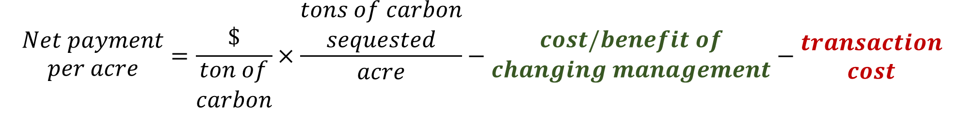
Cost/benefit considerations
$$\begin{matrix}Net payment \\ per acre\end{matrix}=\frac{\$}{\begin{matrix}ton of \\ carbon\end{matrix}}×\frac{\begin{matrix}tons of carbon \\ sequested\end{matrix}}{acre}−\begin{matrix}cost/benefit of \\ changing management\end{matrix}−\begin{matrix}transaction \\ cost\end{matrix}$$
Example costs/benefits of changing management:
  Agronomic benefits to cover-cropping and no-till.
  Cover-crop seed, planting, etc.
  Decrease in fuel use when adopting conservation tillage.
Example transaction costs:
  Entering 5 years of farm management data.
  Subscription for using software like Granular or FieldView Plus.
  Soil sampling if not paid for by the intermediary.

Slide 17
Current Opportunities in KS
Market Administrator | Eligibility Criteria | Data Required | Payment
Bayer | Adopt cover-crops, no-till/strip-till, or both after Jan. 1, 2012. Only corn and soybeans with occasional wheat. | Farm management records; share enrolled acreage using ForGround account. | $5-6 acre/year for no-till/strip-till; up to $6/acre/year for cover cropping; $12/acre/year for both.
Indigo | Adopt cover crops, reduced tillage, precision nitrogen, diversifying crop rotation, or changes to livestock grazing. Field crops. | 3-5 years of historical data plus current season data on tillage, fertilizer applications, planting and harvest, etc. | Currently paying $30 per credit, but price fluctuates with demand. Guaranteed minimum of $15 for 2022 crop.
Nori | Adopted regenerative practices since 2011. No CRP for enrolled area since 2000. Row crops and some orchard/vineyard crops. | 10 years historical data, at least 3 years of records prior to new practice adoption. | $15 currently per Nori Carbon Removal Ton; In the future, producers receive carbon removal tokens to sell.
CarbonNow -Locus AG | Must purchase and apply Locus Ag soil probiotics. Applying the probiotic is the practice change. | 3-5 years historical management data required. Commitment is for 4 or 10 year term. | $12 /acre / year minimum. 75% of annual payment at start of season

Slide 18
Current Opportunities in KS – cont.
Market Administrator | Eligibility Criteria | Data Required | Payment
Agoro | Adopt cover crops, reduced tillage, precision nitrogen, diversifying crop rotation, or changes to livestock/pasture. Field crops, range and pasture. | Data from current crop year and past 5 years on crop rotation, nitrogen use, harvest, and tillage. | $0.05 per lbs N reduced/acre/year; $2.50 /acre/year using one of the 4Rs of nutrient stewardship.
CIBO Carbon Bridge | Cover crops or reductions in tillage. Only corn and soybeans. | Current season data on tillage, fertilizer applications, planting and harvest, etc. Must enroll in CIBO Impact platform. | For no-till and cover crops: up to $35/acre/yr in year one, up to $25/acre/yr in year two, up to $15/acre/yr in year three, up to $10/acre/yr in year four. Producers own carbon credits after year 4 and can sell on CIBO marketplace.
CIBO Carbon Credits | Cover crops, reductions in tillage, or nitrogen management. Only corn and soybeans. | Current season data on tillage, fertilizer applications, planting and harvest, etc. Must enroll in CIBO Impact platform. | Producers own carbon credits and can sell on CIBO marketplace.

Slide 19
Current Opportunities – cont.
Market Administrator | Eligibility Criteria | Data Required | Payment
Corteva | Adopt cover-crops, reduce tillage, reduce nitrogen use, or increase biodiversity. Includes barley, canola, chickpeas, corn, cotton, dry edible beans, dry field peas, flax, lentils, millet, oats, rye, sorghum, soybeans, sunflowers, triticale, dry wheat. | 3 years of historical data plus current season data; Must use Granular Insights software. | 75% of Indigo Ag carbon credit price, guaranteed minimum of $20.
TruTerra | Pathway 1: Adopt cover-crops or reduced/no-till between 2019 and 2021; payments are made on a per ton basis. Includes corn, soybeans, wheat, or cotton in rotation. Pathway 2: Practice changes must be made in fall 2021 or 2022. Same crop systems. | Farm management records prior and during new practice adoption. Must enroll in TruTerra Insights platform. | Pathway 1: Offering $25 per carbon credit from changes in 2021 crop year, $15 for 2020 and 2019. Pathway 2: Pays $2 per acre and producer retains the carbon rights.
Cargill | Conservation agriculture practices like cover-cropping and reductions in tillage. | 4 years of historical data. Must be current or future Cargill grain customer. | Guaranteed minimum of $25 per carbon credit generated.

Slide 20
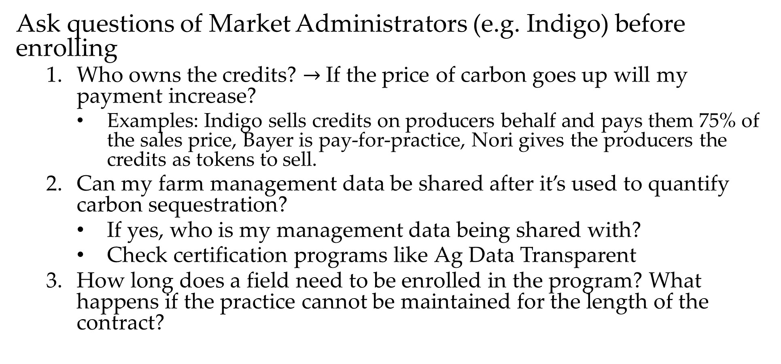
What’s next?
Ask questions of Market Administrators (e.g. Indigo) before enrolling
  Who owns the credits? $→$If the price of carbon goes up will my payment increase?
    Examples: Indigo sells credits on producers behalf and pays them 75% of the sales price, Bayer is pay-for-practice, Nori gives the producers the credits as tokens to sell.
  Can my farm management data be shared after it’s used to quantify carbon sequestration?
    If yes, who is my management data being shared with?
    Check certification programs like Ag Data Transparent
  How long does a field need to be enrolled in the program? What happens if the practice cannot be maintained for the length of the contract?

Slide 21
Pros and Cons of joining a carbon program now
Pro
Con
Payments will begin now when the market is functioning and opportunities for both types of payment exist.
  Payment-for-practices adopted on a per-acre basis.
  Payment for units of carbon sequestered.
Secondary benefits of the practices being adopted.
  This includes agronomic improvements or things like using cover-crops for grazing.
Sometimes programs have a discount for products from their parent company. This could be discounted use of their software or a discount on their brand of seed.
Some programs require entering up to 5 years of production data including crop rotation, fertilizer applications, etc.
  Look closely at how production data can be shared for each program.
Compensation is dependent on compliance with a contract which can vary in length (1 to 10 years).
Joining a program which sells the credits you produce in the present may mean you miss out if carbon prices increase in the future.

Slide 22
Outlook - Future policies and opportunities
Growing Climate Solutions Act of 2022
  Would authorize USDA to create two programs designed to assist producers in entering voluntary environmental credit markets
    Greenhouse Gas Technical Assistance Provider
    Third-Party Verifier Certification Program
Global prices for carbon
  Price of EU carbon permits at close on March 22nd, 2023 was $101.89.
Upcoming Market Administrators and Opportunities
  Ecosystem Services Market Consortium – One project in KS with General Mills focused on wheat acreage. ESMC hopes to produce credits for additional services (water quality, erosion control, etc.)
  Soil and Water Outcomes Fund – Plans to pay for other environmental services, like improvements to water quality, in addition to carbon sequestration.

Slide 23

Questions?
Comments?
Use this link or the QR code below:
https://tinyurl.com/KScarbonfarm
Feel free to reach out at:
mcameronharp@ksu.edu
(585)-705-0015
Copies of my slides are available at my website :
mcameronharp.com

